Slide 1
Current and Future Measurements of Total and Spectral Solar Irradiance by NASA and NOAA
P. Pilewskie and T. Woods
Laboratory for Atmospheric and Space Physics, University of Colorado, Boulder, CO USA
²NASA Goddard Space Flight Center, Greenbelt, MD USA

Slide 2
Outline
NASA SORCE Mission: advances in TSI and TSI
SORCE TIM established new TSI
SORCE SIM spectral variability: current validations studies
The loss of Glory: filling the TSI gap yet again
TSI Calibration Transfer Experiment
JPSS Total and Spectral Solar Irradiance Sensor: TSIS
TSIS TIM with expected 100 ppm uncertainty
The first SIM follow-on: lessons learned.
Now 2016 launch expected
Summary and Conclusions

Slide 3
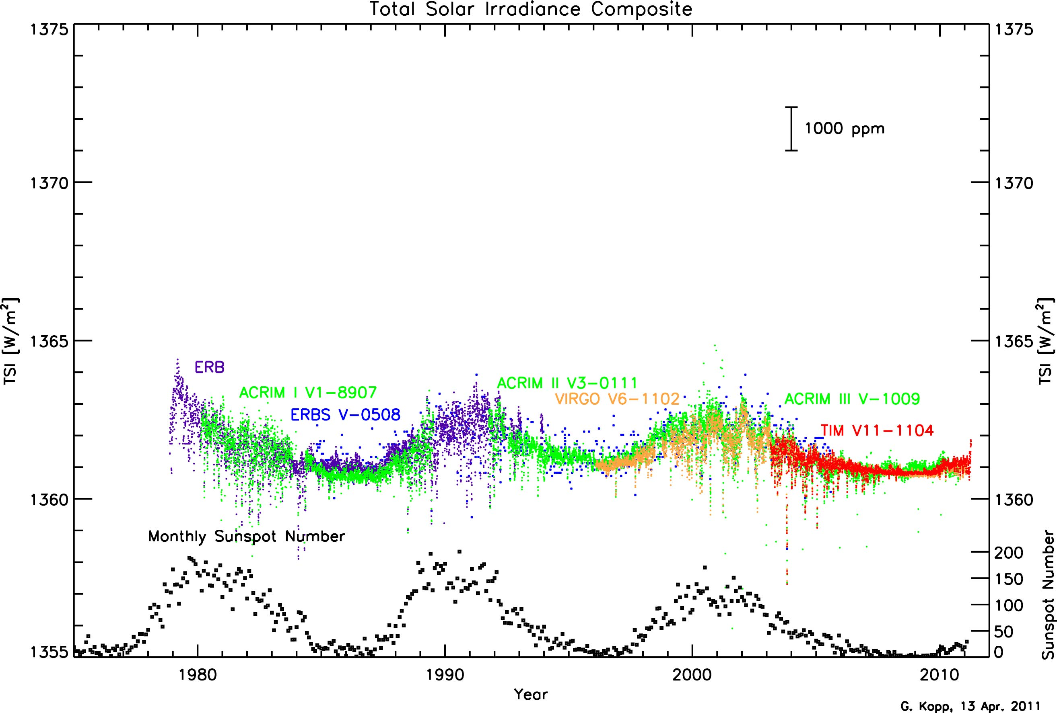
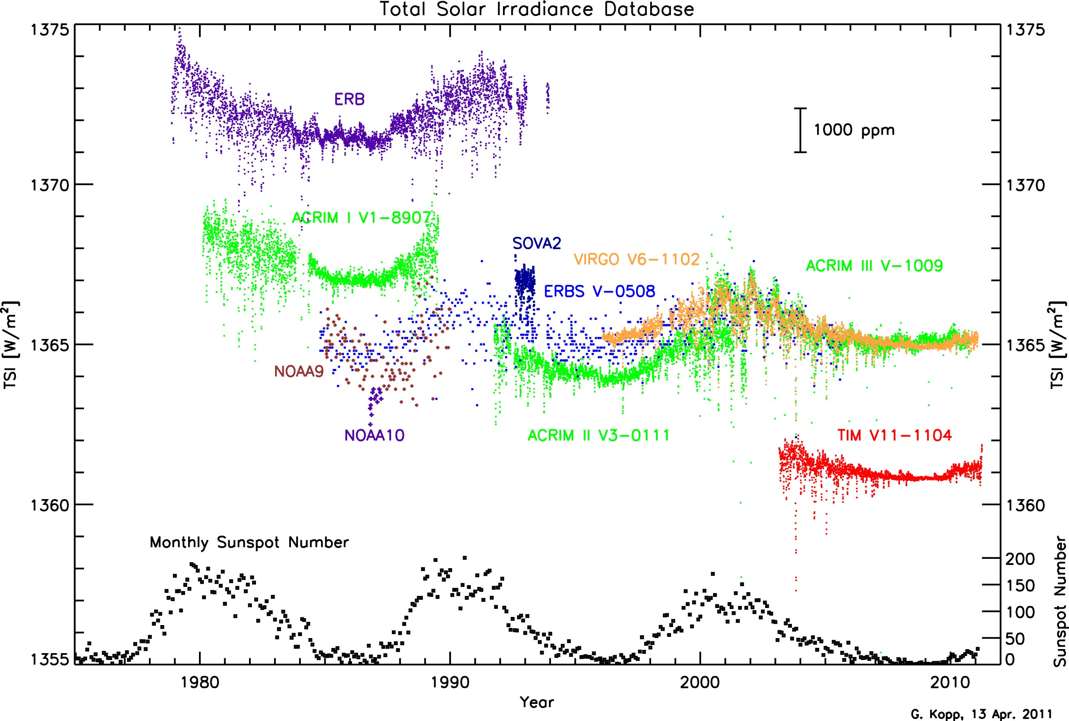
The Total Solar Irradiance Data Record

Slide 4
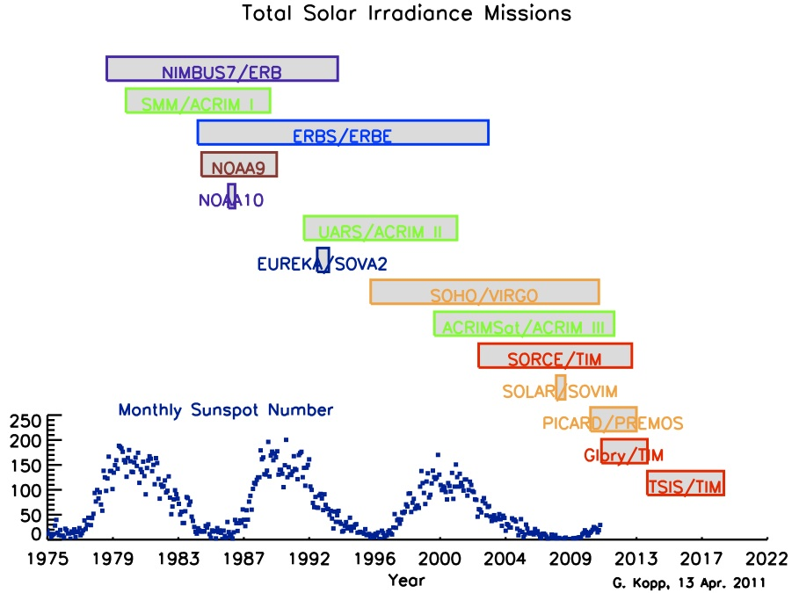
Record Currently Relies on Stability & Continuity
TSI plots updated regularly at:
http://spot.colorado.edu/~koppg/TSI/

Slide 5
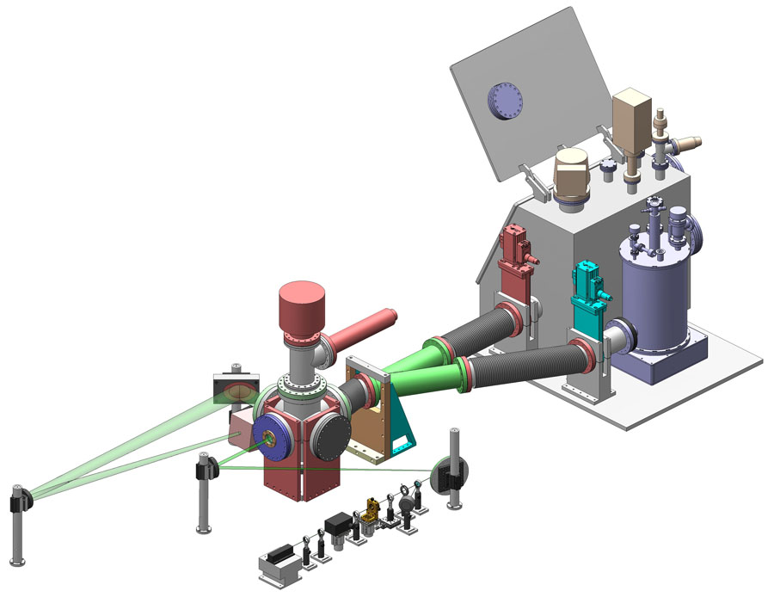
TSI Radiometer Facility (TRF) Measures Irradiance
The TRF:
Improves the calibration accuracy of future TSI instruments,
Establishes a new ground-based radiometric irradiance reference standard, and
Provides a means of comparing existing ground-based TSI instruments against this standard under flight-like operating conditions.
Glory/TIM and PICARD/PREMOS are the first flight TSI instruments to be validated end-to-end
First facility to measure irradiance
at solar power levels
in vacuum
at desired accuracies
Kopp et al., SPIE 2007

Slide 6
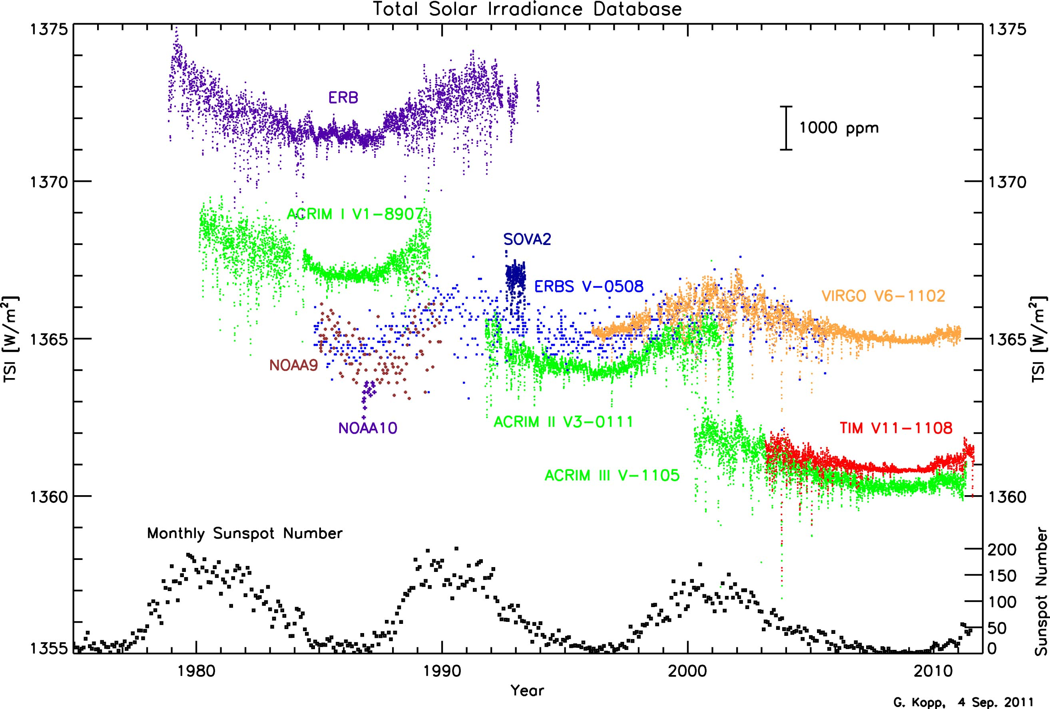
TRF Corrections Now Applied by ACRIM Team ...

Slide 7
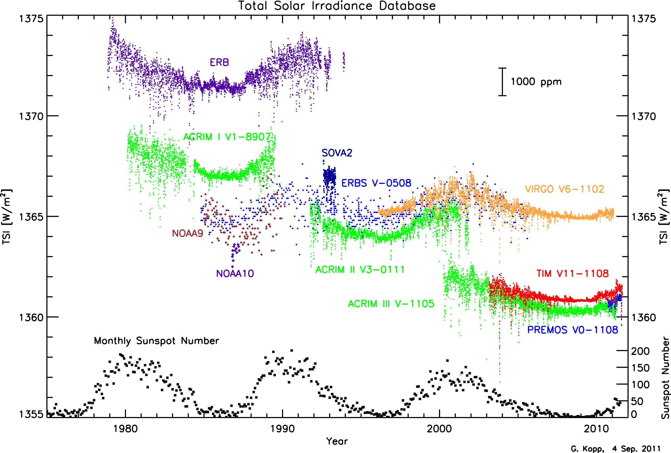
... And PREMOS Data Are Recently Available

Slide 8
The TSI Continuity Transfer Experiment (TCTE)
Maintaining stability in the Total Solar Irradiance (TSI) data record that has been continuous for 33 years
The 5-yr SORCE mission is into its 9th year and battery is degrading
GLORY-TIM lost in 2011
TSIS/TIM on JPSS-FreeFlyer1 delayed until mid 2016
TCTE Selected to fly on STP-Sat3
For success need to transfer TSI from SORCE/TIM to TSIS/TIM
Need overlapping measurements with TCTE and each of these missions
TCTE measurement requirements
Absolute accuracy better than 350 ppm (0.035%)
Stability better than 10 ppm / year (0.001%)

Slide 9
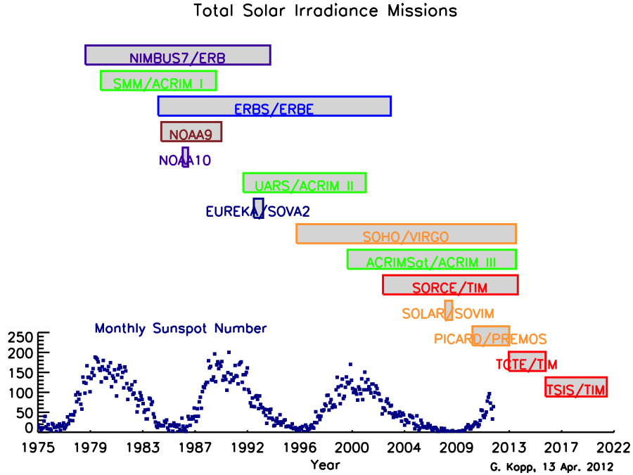
Record Currently Relies on Stability & Continuity
With launch failure of NASA’s Glory mission, record continuity is at risk
TSI plots updated regularly at:
http://spot.colorado.edu/~koppg/TSI/

Slide 10
TSIS TIM Uncertainty Budget
Correction | Origin | Value [PPM] | 1σ [PPM]
Distance to Sun, Earth & S/C | Analysis | 33,537 | 0.1
Doppler Velocity | Analysis | 57 | 0.7
Shutter Waveform | Component | 100 | 1.0
Aperture | Component | 1,000,000 | 28
Diffraction | Component | 452 | 46
Cone Reflectance | Component | 182 | 35
Non-Equivalence, ZH/ZR-1 | Instrument | 782 | 43
Servo Gain | Instrument | 2,115 | 0.0
Standard Volt +DAC | Component | 1,000,000 | 15
Pulse Width Linearity | Component | 800 | 3
Standard Ohm + Leads | Component | 1,000,000 | 25
Dark Signal | Instrument | 1,645 | 14
Pointing | Analysis | 100 | 10
Measurement Repeatability (Noise) | Instrument | - | 4
Uncertainty due to Sampling | Analysis | - | 12
Total RSS |  |  | 85.5

Slide 11
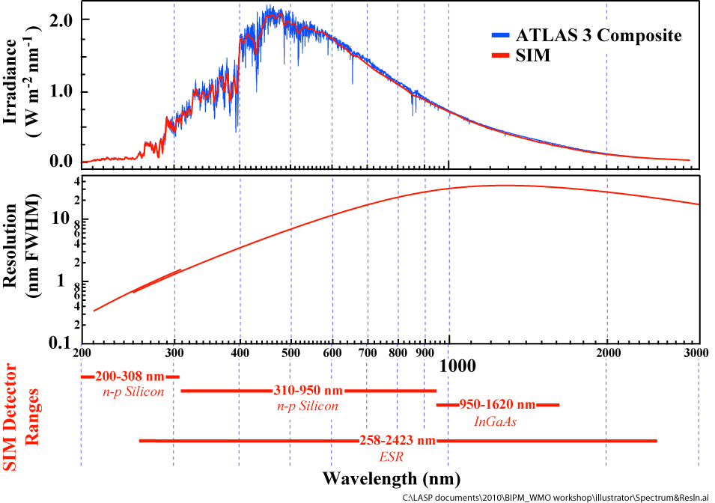
SIM and SOLSPEC Solar Spectral Irradiance
J.W. Harder, G. Thuillier, E.C. Richard, S.W. Brown, K.R. Lykke, M. Snow, W.E. McClintock, J.M. Fontenla, T.N. Woods, P. Pilewskie, 'The SORCE SIM Solar Spectrum: Comparison with Recent Observations' ,Solar Physics, 263, Issue 1 (2010), pp 3, doi:10.1007/s11207-010-9555-y

Slide 12
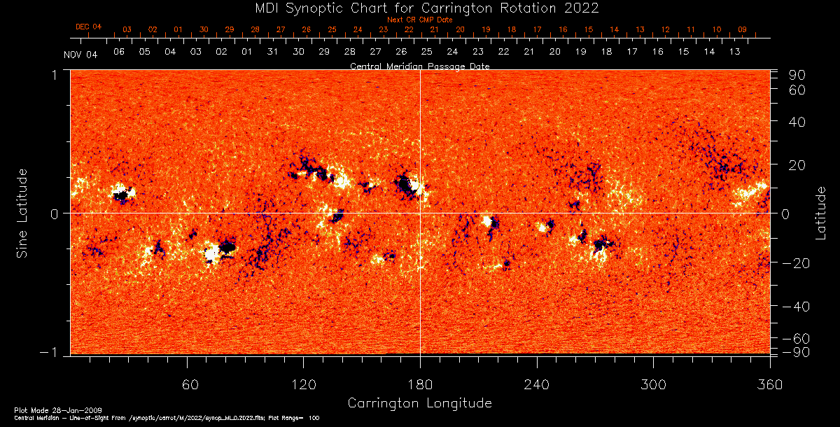
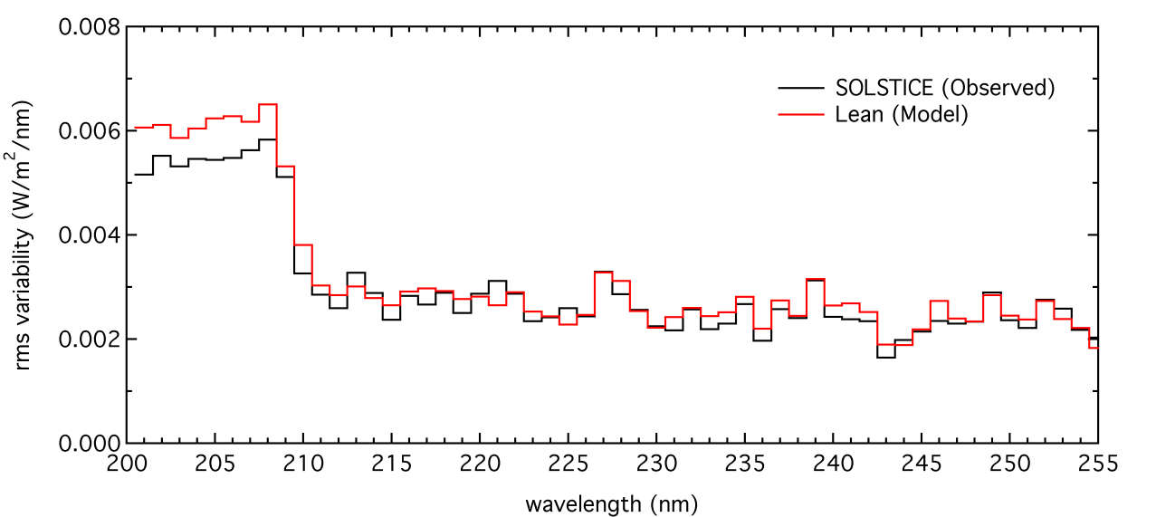
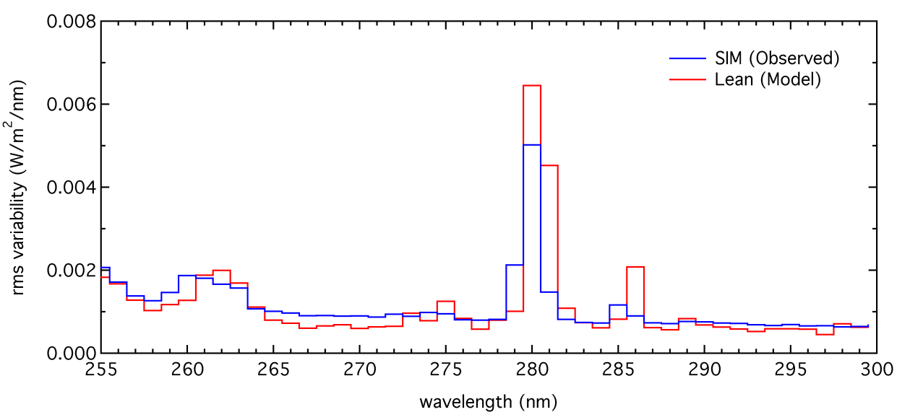
Solar Rotational Variability

Slide 13
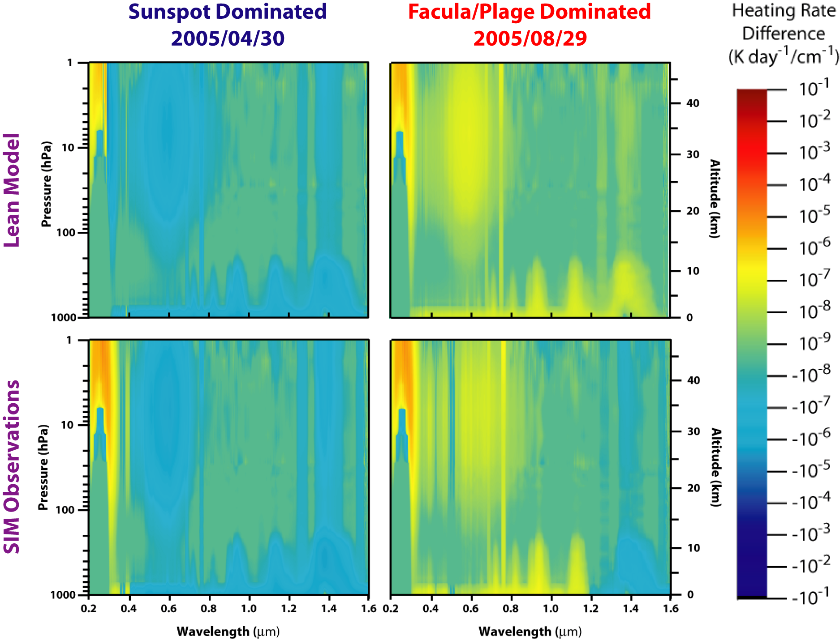
Spectral Heating Rate Differences

Slide 14
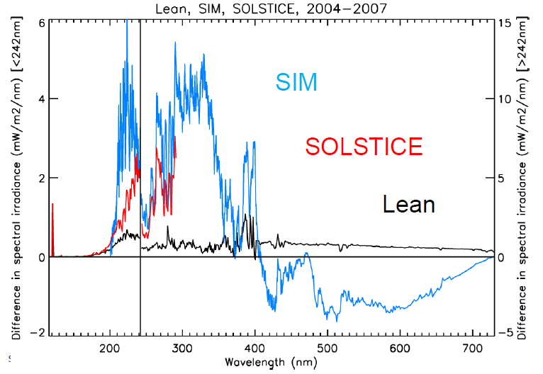
(near) Solar Cycle Variability

Slide 15
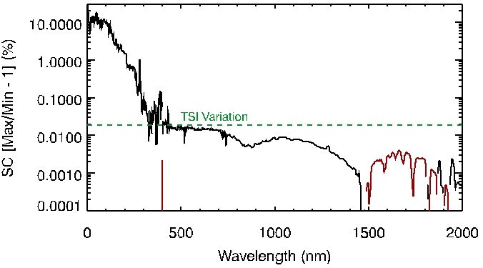
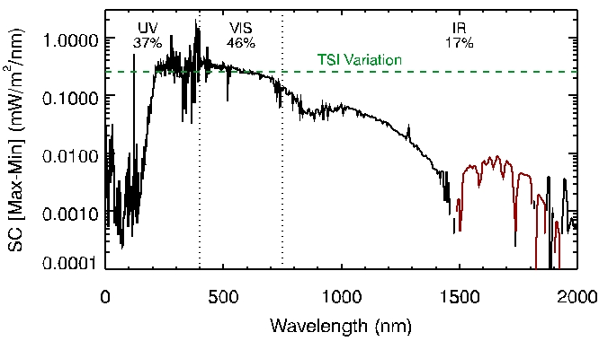
NRL SSI (J. Lean) model variability
UV varies the most when variability is given as a ratio (percentage)
However…
Variability in energy units is more appropriate for climate studies
UV
Note that red lines are variations that are out of phase with the solar cycle.
Solar Cycle (SC) variability from the NRL SSI model
(J. Lean)
Notes:
Figures are solar cycle (SC) variability from the NRL SSI model (J. Lean) developed prior to SORCE mission.

Slide 16
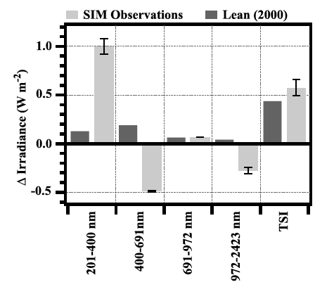
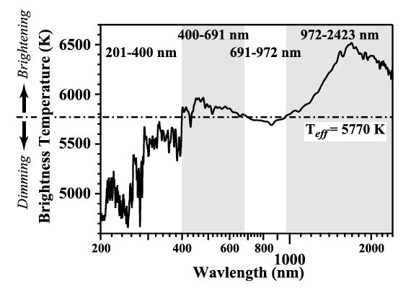
SSI variability from SORCE
In addition to the infrared, some visible wavelengths are out of phase with the solar cycle
Also, there is more UV variability than expected
Are the SIM and model differences possibly related to unresolved instrument trends?
Checking these results is challenging as SORCE SIM is the only daily SSI observations at > 400 nm
Other validation techniques are needed than direct comparisons
Out of Phase
Wavelengths
Figures from J. Harder et al., GRL, 2009

Slide 17
SIM Degradation Trending Challenges
What is the reference with only two SIM channels and both are degrading?
SIM-A is used daily with one observation per day without its hard radiation trap and about 14 observations with HRT.
SIM-B is used about once a month for cross calibrations for SIM-A and thus degrades slower.
One equation, but two unknowns
Degrade_{A} and Degrade_{B} are the two unknowns

Slide 18
SIM Degradation Trending Challenges
What is the reference with only two SIM channels and both are degrading?
Current SIM results are derived with assumption that both channels degrade at same rate as a function of exposure time
Key result from SSI Validation Workshop at NIST in Feb. 2012: degradation scales with dose
New SIM analysis is in progress

Slide 19
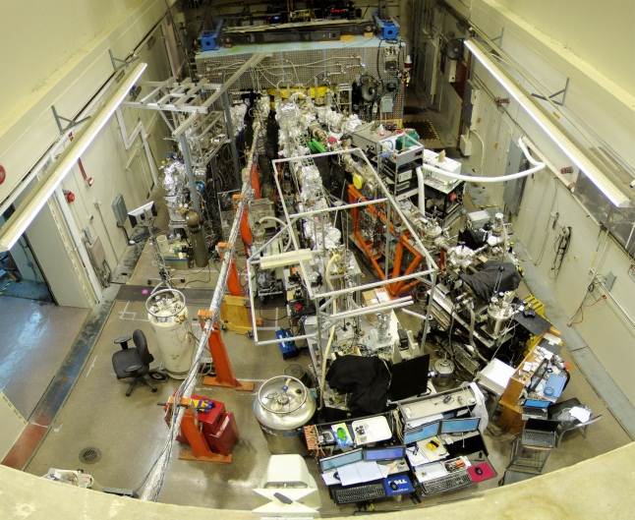
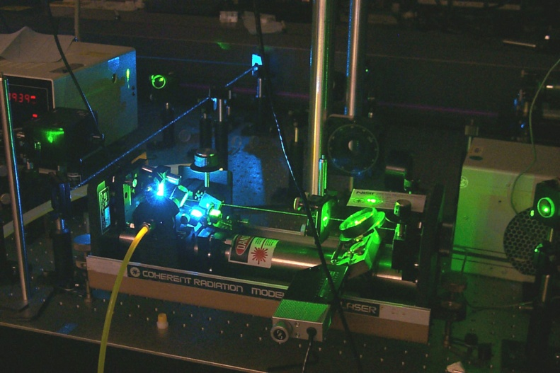
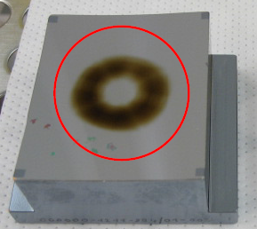
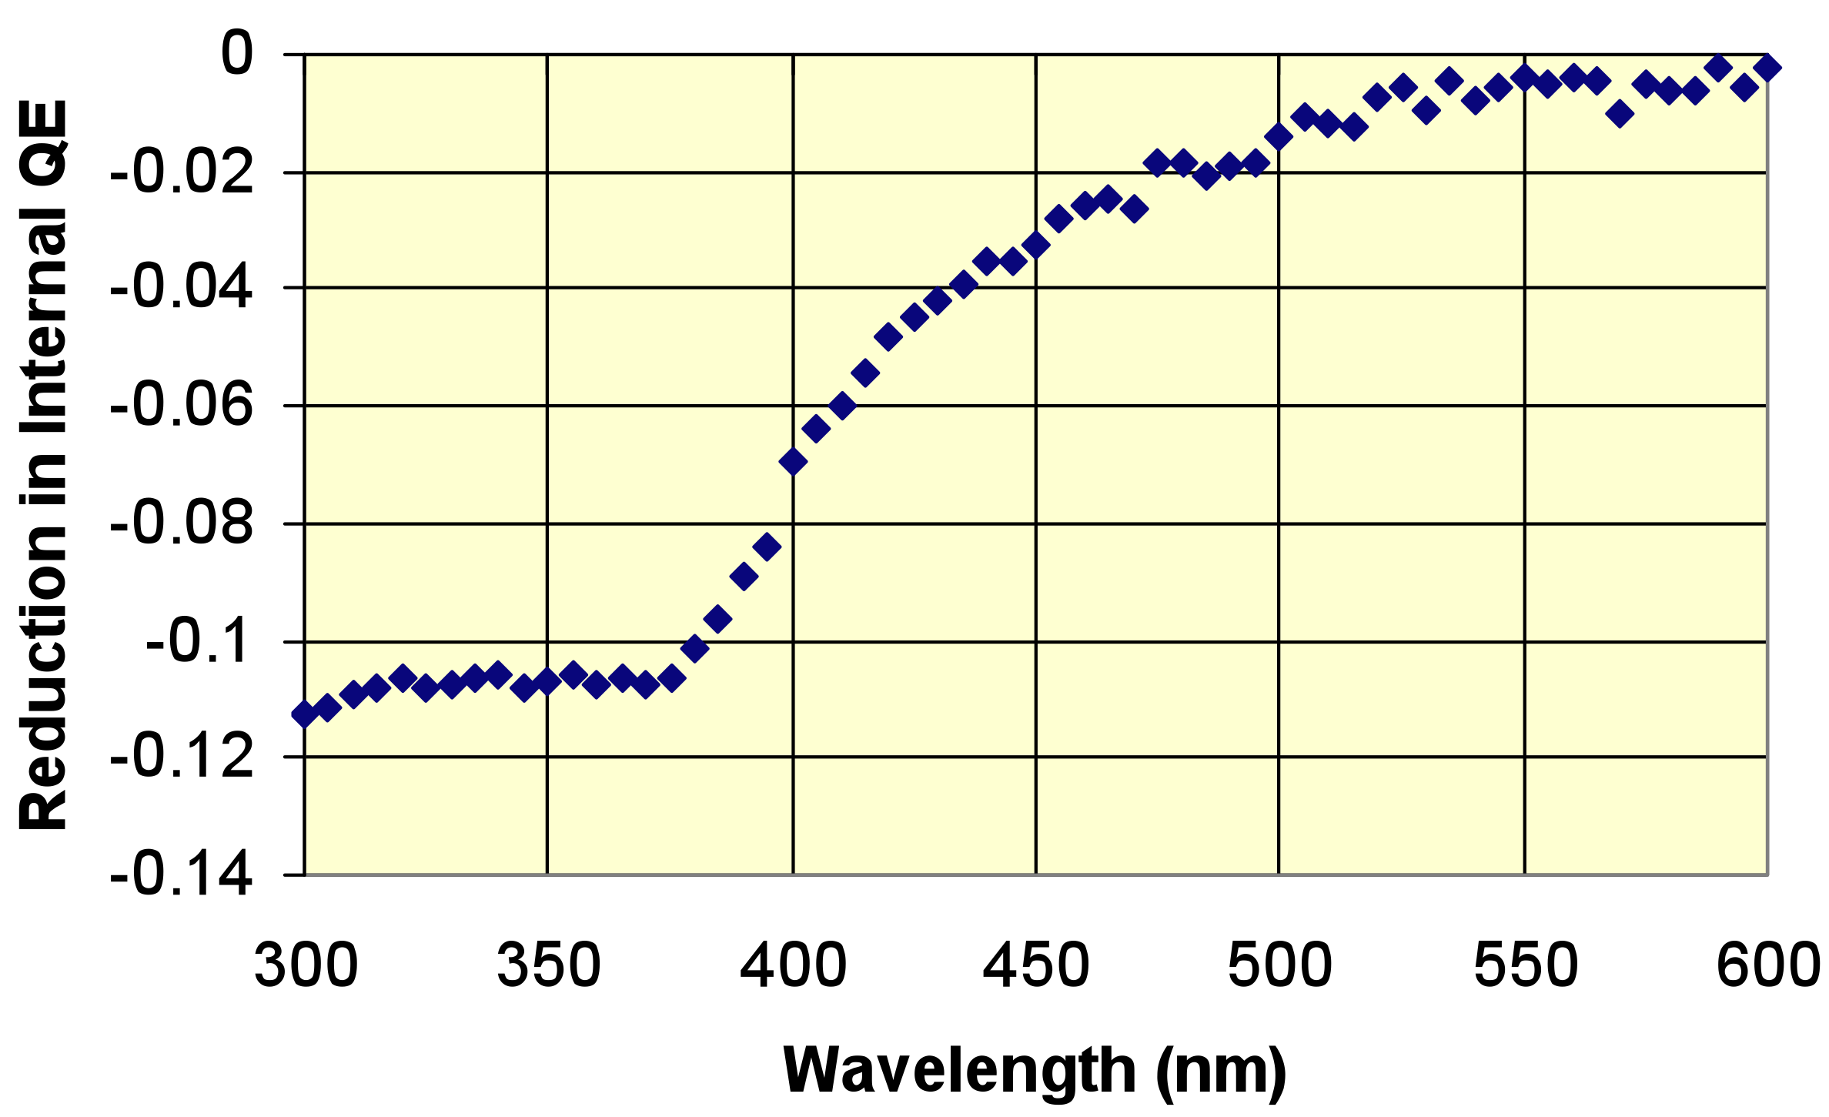
SSI Validation Workshop NIST 28 Feb – 1 Mar 2012
NIST
SURF
NIST
SIRCUS
Several laboratory results were presented on how optics and detectors degrade with exposure to UV radiation
Some Lessons Learned
Carbon deposit is common, but complex, cause for optics degradation.
Most degradation of optics and detectors occurs shorter than 500 nm.
There is often recovery after exposure.
Dose (fluence of UV photons) is better model than just exposure time for estimating degradation rates.

Slide 20
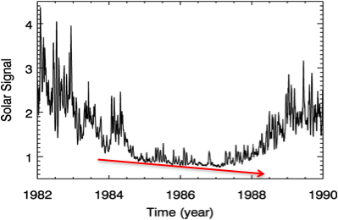
Trending across solar cycle minimum could provide new method of validation
The solar cycle trend switches direction before and after cycle minimum, but instrument degradation trend is expected to continue across the minimum.
Trending over both declining and rising phases of the solar cycle can help clarify, or at least bound, how much of the trend is due to instrument degradation.
The instrument degradation is more clear over the solar cycle minimum.

Slide 21
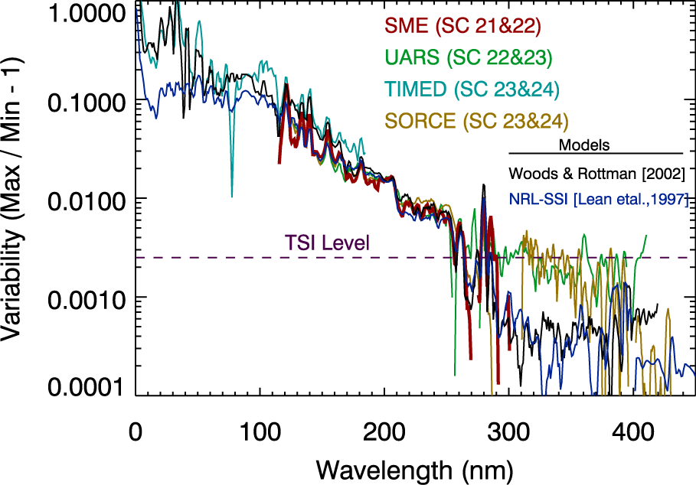
Comparison of all missions show consistency for 4 different solar cycles
Empirical models (Lean, Woods) and observations are in good agreement for wavelengths shorter than 290 nm
Models appear to significantly underestimate variability above 290 nm

Slide 22
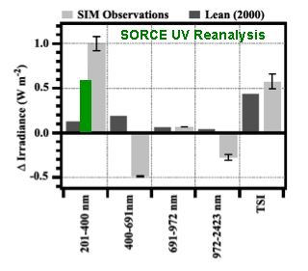
This reanalysis indicates less variability than Harder et al. 2009 but still much larger than Lean 2000 model

Slide 23
Comparison of UV variability from recent papers
Harder et al., 2009 (4/2004 – 2/2008) ΔTSI=0.523 W/m²
% of ΔTSI →
25%
190%
110%
60%
40%
Woods & Rottman
(2002) Model
Morrill et al. (2011)
Krivova et al. (2006)
Woods Reanalysis
Note that 0-200 nm cycle variability is ~3% of ΔTSI

Slide 24
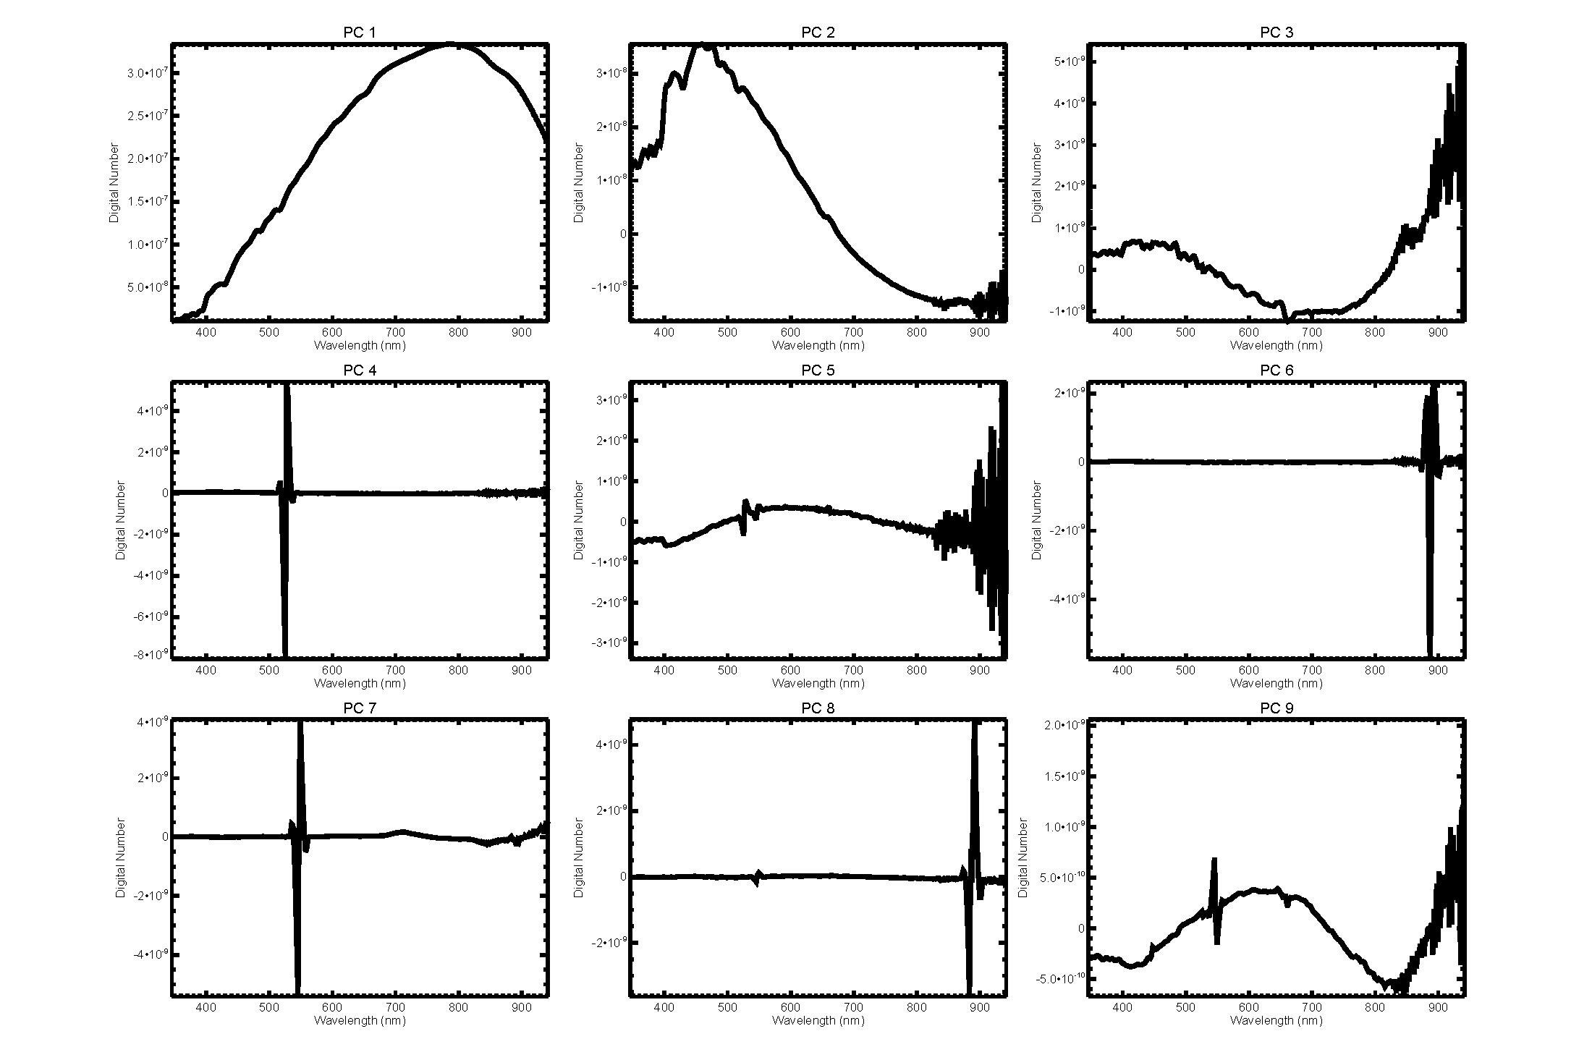
Principal Component Analysis

Slide 25
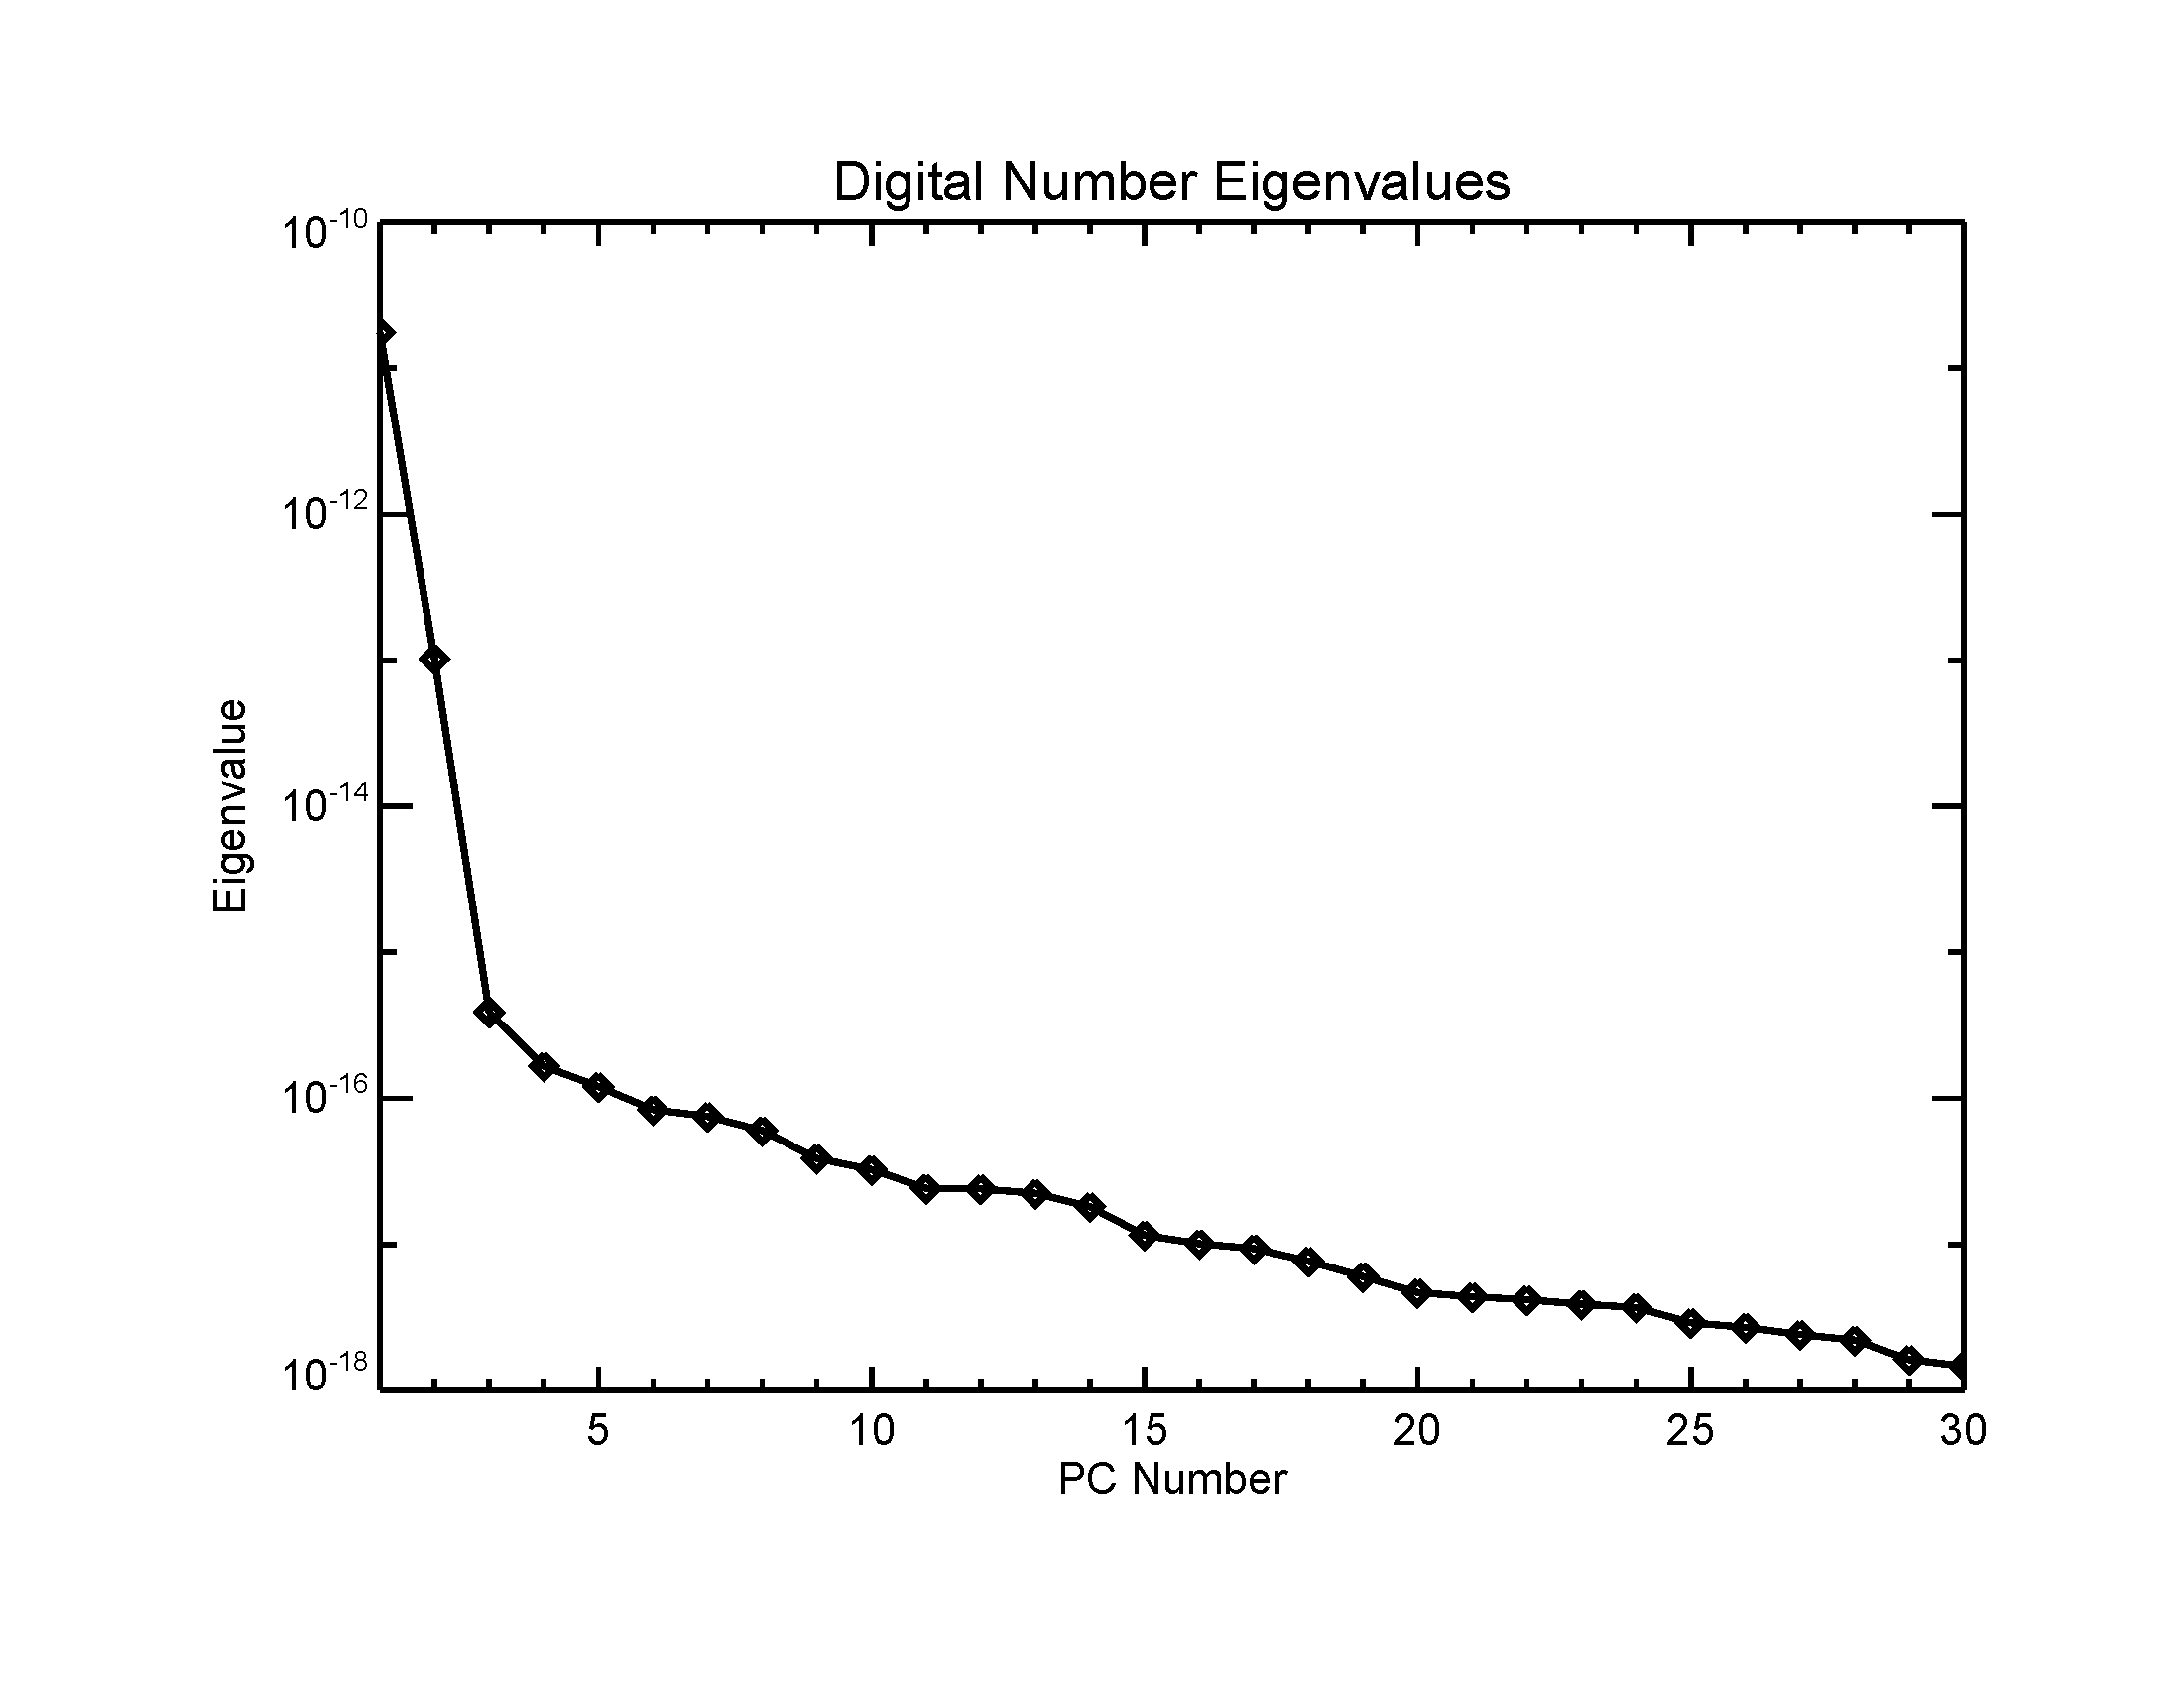

Slide 26
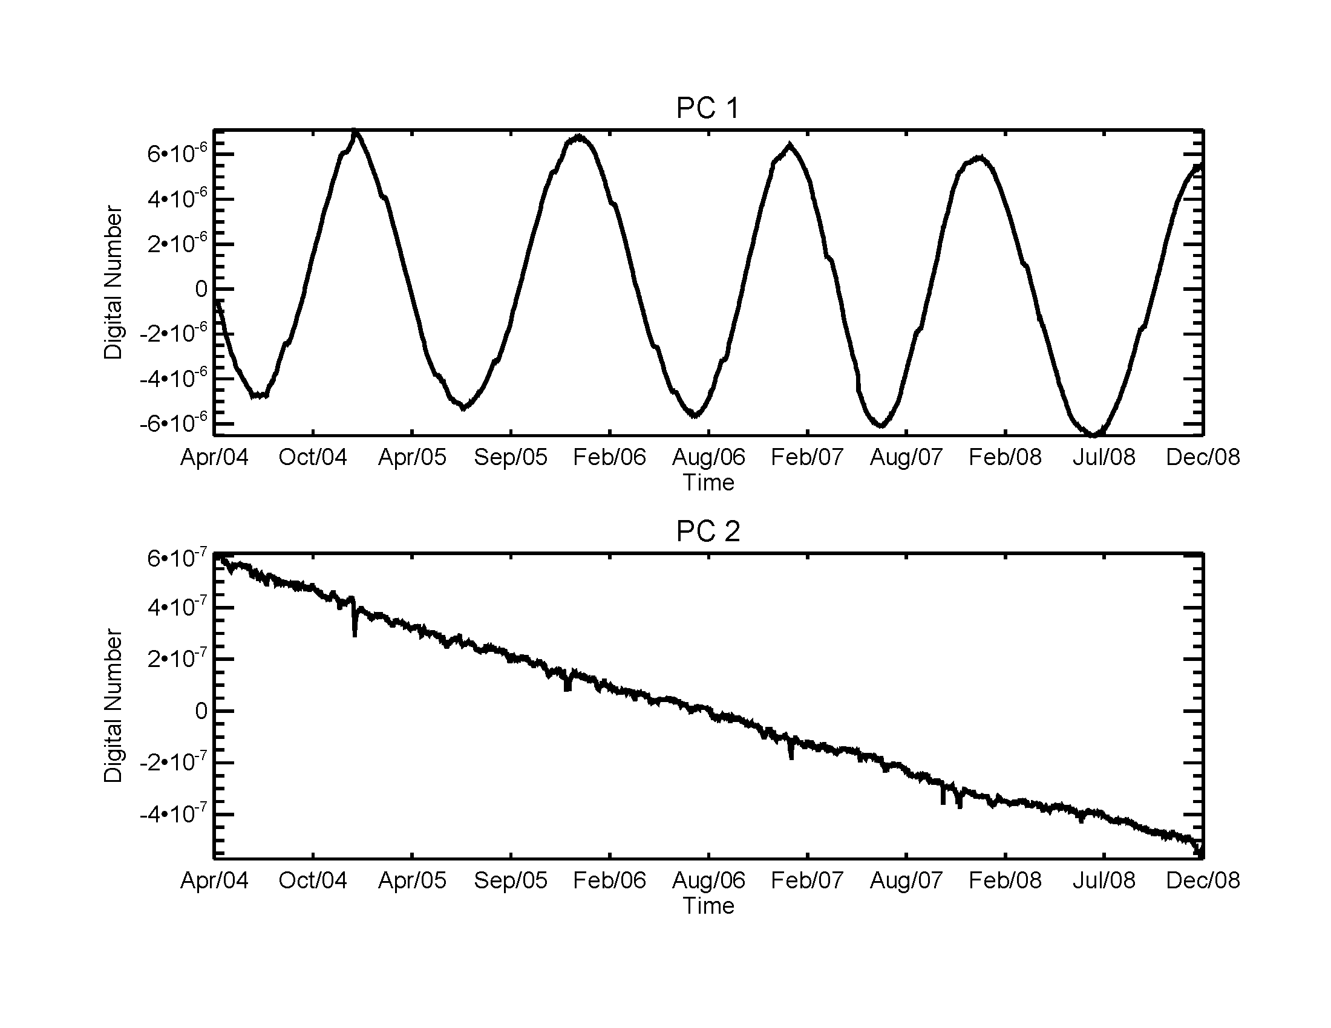
PC Time series

Slide 27
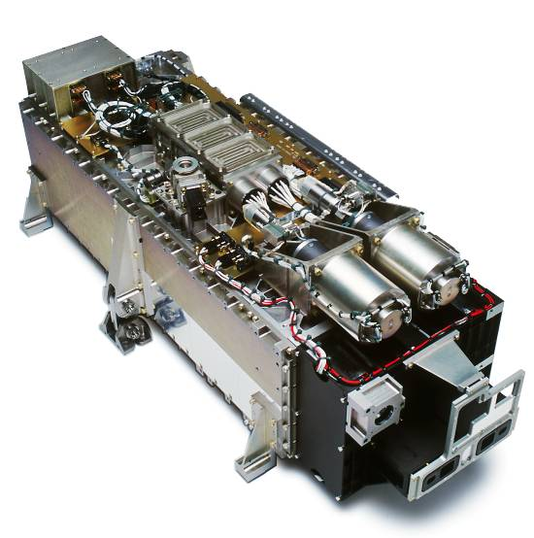
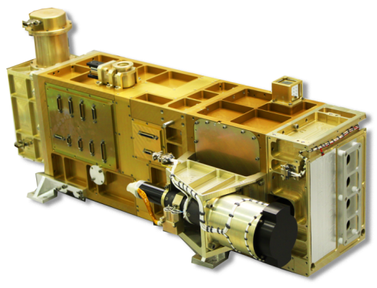
TSIS SIM Development Approach
TSIS SIM designed for long-term spectral irradiance measurements (climate research)
Incorporate lessons learned from SORCE SIM (& other LASP programs) into TSIS SIM to meet measurement requirements for long-term JPSS SSI record
Specific areas addressed in TSIS SIM development:
Reduce uncertainties in prism degradation correction to meet long-term stability requirement
Ultra-clean optical environment to mitigate contamination
Addition of 3rd channel to reduce calibration uncertainties
Improve noise characteristics of ESR and photodiode detectors to meet measurement precision requirement
ESR : Improved ESR thermal & electrical design
Photodiodes : Larger dyn. range integrating ADC’s (21-bits)
Improve absolute accuracy pre-launch calibration
NIST SI-traceable Unit and Instrument level pre-launch spectral calibrations (SIMRF-SIRCUS)
SORCE SIM
TSIS SIM

Slide 28
TSIS SIM Calibration Error Budget
Instrument uncertainties determined at the component level --> characterization of error budget
Measurement Correction | Origin | Value (ppm) | 1σ (ppm) | Status
Distance to Sun, Earth & S/C | Analysis | 33,537 | 0.1
Doppler Velocity | Analysis | 43 | 1
Pointing | Analysis | 0 | 100
Shutter Waveform | Component | 100 | 10
Slit Area | Component | 1,000,000 | 300
Diffraction | Component | 5,000-62,000 | 500
Prism Transmittance | Component | 230,000-450,000 | 1,000
ESR Efficiency | Component | 1,000,000 | 1,000
Standard Volt + DAC | Component | 1,000,000 | 50
Pulse Width Linearity | Component | 0 | 50
Standard Ohm + Leads | Component | 1,000,000 | 50
Instrument Function Area | Instrument | 1,000,000 | 1,000
Wavelength (Δλ/λ = 150 ppm) | Instrument | 1,000,000 | 750
Non-Equivalence, Z_{H}/Z_{R}-1 | Instrument | 2,000 | 100
Servo Gain | Instrument | 2,000 | 100
Dark Signal | Instrument | 0 | 100
Scattered Light | Instrument | 0 | 200
Noise | Instrument | - | 100
Combined Rel. Std. Uncertainty |  |  | 2000
Complete
In-progress
S/C
Component-Level
Dominant uncertainties are l-dependent
Instrument-Level

Slide 29
Calibration and Verification
SIM traces its calibrations to the standard Watt.
All elements of SIM instrument equations are calibrated at either the component or instrument level.
Analog to the TSI Radiometer Facility: end-to-end verification of SIM with NIST Spectral Irradiance and Radiance Responsivity Calibrations using Uniform Sources (SIRCUS) and a new LASP SSI Radiation Facility.

Slide 30
TSIS Top Level Requirements
Level 1 Performance Requirement Parameter | TIM Requirement | SIM Requirement
Measured Spectrum | Total solar spectrum | 200-2400 nm
Measurement Accuracy | 0.01% with noise < 0.001% | 0.2%
Measurement Stability (long term) | 0.001% per year | 0.05%/yr (<400 nm) 0.01%/yr (>400 nm)
Spectral Resolution | n/a | 1 nm: (< 280 nm) 5 nm: (280 to 400 nm) 35nm: (>400 nm)
Reporting Frequency | 4 six hourly averages per day | 2 spectra per day
Data processing approach | Consistent with SORCE approach for continuity | Consistent with SORCE approach for continuity

Slide 31
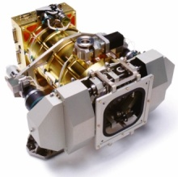
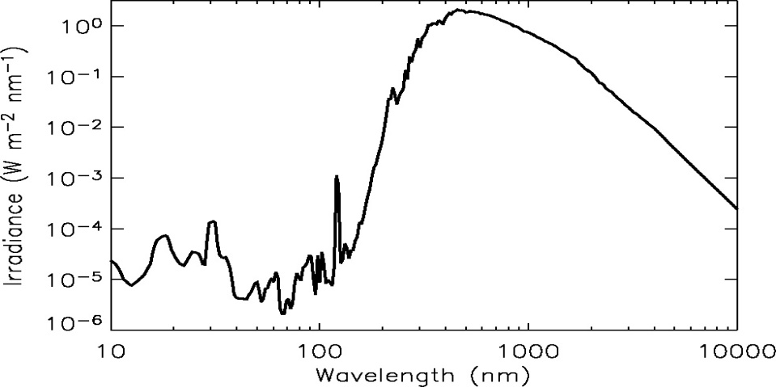
Summary
TCTE launch June 2013 intended to maintain TSI Data Record Continuity
Glory loss threatened gap in solar irradiance record, but …
Spare SORCE/TIM originally intended for Shuttle flights being refurbished
TCTE intended to overlap SORCE by 50+ days, and Free-Flyer TSIS by 50+ days
TCTE lacks the Spectral Irradiance Monitor (SIM), but TSIS will include SIM
Likely Gap in 10+ year record of SORCE-SIM Solar Spectral Irradiance
TSIS Free Flyer launch expected July 2016
TSIS Flight Model (FM-1) on schedule for delivery Dec 2012
TSIS Flight Free Flyer TSIS measures both TSI with TIM, & SSI with SIM
Free Flyer also includes SARSAT and NOAA User Services ADCS
TIM
TIM
SIM
SIM
Notes:
31

Slide 32
Summary
SIM and SOLSPEC agree to within 1% over most of spectrum.
Models can adequately reproduce rotational SSI variability.
Solar-cycle variability in some SIM spectral bands exhibits out-of phase trends with TSI.
Climate implications? Observations require further validation.
Continued validation efforts underway
New models of SORCE SIM degradation
New measurement-based degradation studies
Degradation estimates over solar minimum.
SORCE SIM in the present solar cycle? SORCE/TSIS SIM overlap?
TSIS SIM will have enhanced degradation tracking capability, lower noise ESR, ultra-clean optical environment to mitigate contamination, first end-to-end cal/val using cryogenic radiometer and SIRCUS sources.

