Slide 1
Topical workshop RECENT VARIABILITY OF THE SOLAR SPECTRAL IRRADIANCE AND ITS IMPACT ON CLIMATE MODELLING
COST ACTION ES1005 TOSCA
TOwards a more complete assessment of
the impact of Solar variability on the Earth’s Climate
Freie Universität, Berlin, 14-16 May 2012

Slide 2
PRACTICAL INFO
WiFi access to the internet: get code at the reception desk.
Lunch: light lunch at 12:30, buffet service (one floor down)
Conference dinner: 15 May evening at 19:30 at the restaurant "Ständige Vertretung" at Schiffbauerdamm 8 in the city centre of Berlin.
Participants supported by COST: please sign attendance sheet every day.

Slide 3
WHAT TOSCA IS
TOSCA is a multidisciplinary European network of scientists from more than 18 countries whose objective is to provide a better understanding of the hotly debated role of the Sun in climate change.
TOSCA aims at assessing the various contributions of solar variability to the Earth’s climate by bringing together solar physicists, space scientists, atmospheric scientists, climate modellers, paleoclimatologists, and more.

Slide 4
WHAT TOSCA IS
TOSCA started in June 2011 and will last for 4 years. As for other COST (Cooperation in Science and Technology) actions, the main role of TOSCA is to foster interactions between different communities.
TOSCA has 5 working groups: •WG1 impact of solar radiative forcing •WG2 impact of interplanetary perturbations •WG3 impact of energetic particles •WG4 interfacing between upper and lower atmospheric layers and corresponding models •WG5 outreach and dissemination (GHOST)

Slide 5
SCOPE OF THIS WORKSHOP
To review current knowledge on the matter of solar spectral variability and its influences on the Earth's climate.
To update available results in the literature.
To initiate some new comparisons of the different results by each author/workshop participant.
Please, consider this during your presentation.

Slide 6
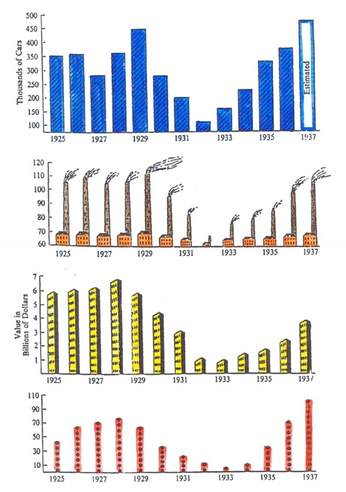
SCOPE OF THIS WORKSHOP
To go beyond this kind of approach!
courtesy: S. K. Solanki

Slide 7
EXPECTED OUTCOME
A peer-reviewed paper summarizing the current knowledge and understanding of the spectral solar irradiance variability and its atmospheric impact in climate models.
Editorial Board : Natasha Krivova, Klareti Tourpali, Mark Weber + workshop organizers
The editorial board has already started the careful planning and coordination of the writing. The splinter groups on Tuesday as well as the discussion time will be devoted to arrange paper contents and methods to fulfil the goal of the paper submission by June 30th 2012.

Slide 8
PROGRAM
Monday, 14 May 2012
Morning: SSI measurements
Afternoon: Models of SSI variations
Tuesday, 15 May 2012
Morning: Climate impact of SSI measurements
Afternoon: Climate impact of SSI measurements
Splinter discussions
Wednesday, 16 May 2012
Morning: Final wrap-up

