Slide 1
Open licences for research data publications
Coffee Lecture, 08. Dec. 2022
Andreas Hübner
Esther Asef
Referentin für Forschungsdatenmanagement
https://www.fu-berlin.de/forschungsdatenmanagement
Published here: https://www.geo.fu-berlin.de/bibliotheken/Aktuelles/Coffee-Lectures-SommerSemester-2022.html
Licenced under a Creative Commons Attribution 4.0 International Licence. Exceptions are noted.
Notes:
Das Ziel von Open Science ist es u.a., wissenschaftliche Produkte (Literatur, Forschungsdaten) für alle Men­schen frei zugänglich und nachnutzbar zu machen,
… kostenlos und möglichst ohne technische und rechtliche Barrieren.

Slide 2
Copyright / Open licences
All rights reserved
Some rights reserved
Open licences
https://creativecommons.org

Slide 3
Urheberrecht / Copyright
Journal-Article
PhD, MSc, BSc thesis
Poster
Report
Book(chapter)
Software
etc…
Research Data
not
copyright
protected
copyright
protected
Software: https://opensource.org/faq#which-license
Notes:
Use this universal tool if you are a holder of copyright or database rights and you wish to waive all your interests, if any, in your work worldwide. This may be the case if you are reproducing an underlying work that is in the public domain and want to communicate that you claim no copyright in your digital copy where copyright law may grant protection.
mit einer CC-Lizenz weitgehende Nutzungsfreiheiten einräumen

Slide 4
Urheberrecht / Copyright
Text (e.g. transcipts)
Video
Photo
Audio
Satellite image
Software
Numerical data
Research Data
not
copyright
protected
copyright
protected
Databases
Software: https://opensource.org/faq#which-license
Notes:
Use this universal tool if you are a holder of copyright or database rights and you wish to waive all your interests, if any, in your work worldwide. This may be the case if you are reproducing an underlying work that is in the public domain and want to communicate that you claim no copyright in your digital copy where copyright law may grant protection.
mit einer CC-Lizenz weitgehende Nutzungsfreiheiten einräumen

Slide 5
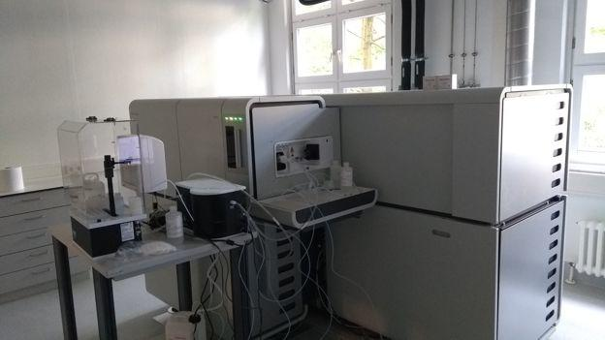
Numerical data: no copyright!
Thermometer: 5 €
MC-ICP-MS: 1.000.000 €
T = 12°C
δ⁶⁶Zn = +0.32 ± 0.08‰
Thermometer icon: OpenClipart, public domain; Photo: https://www.geo.fu-berlin.de/en/geol/fachrichtungen/geochemhydromin/geochemie/_news/Neoma.html
Notes:
Normal treatment
Normal quality treatment: exclusion of outliers,
Standard quality assurance: exclusion of outliers, or calculations for standardised data reporting: Delta-values in isotope research.

Slide 6
https://creativecommons.org

Slide 7
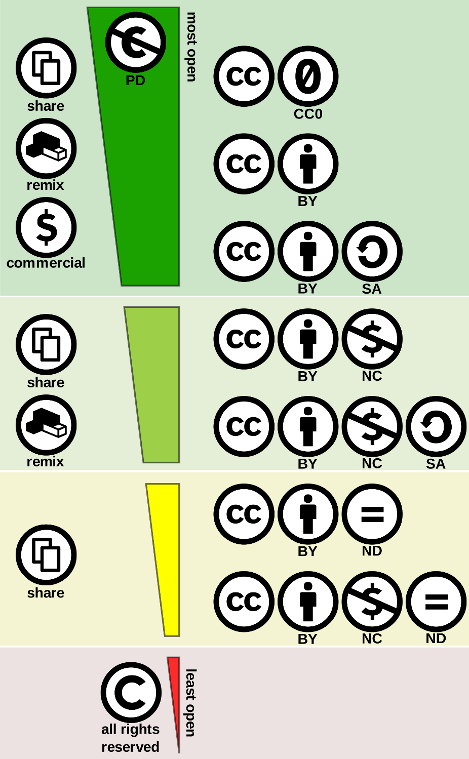
CC0 for open science datasets
Fact Sheet on Creative Commons & Open Science. 10.5281/zenodo.840651
Quelle: Creative commons license spectrum
Shaddim, CC-Namensnennung 4.0 international
Notes:
use CC0 and simply ask for credit (rather than require attribution), and provide a citation for the dataset that others can copy and paste with ease. Such requests are consistent with scholarly norms for citing source materials.
CC0 does not exempt researchers from the obligation of citing the original data authors.
https://f1000research.com/about
Data associated with F1000Research articles (not posters, slides and documents unless specifically stated) are made available, where possible, under the terms of a Creative Commons Public Domain Dedication (CC0 license). This facilitates and encourages data re-use and helps prevent the problems of attribution stacking when combining multiple datasets each authored by multiple authors that use multiple different licenses.

Slide 8
CC0 for open science datasets
Fact Sheet on Creative Commons & Open Science. 10.5281/zenodo.840651
Quelle: Creative commons license spectrum
Shaddim, CC-Namensnennung 4.0 international
Notes:
use CC0 and simply ask for credit (rather than require attribution), and provide a citation for the dataset that others can copy and paste with ease. Such requests are consistent with scholarly norms for citing source materials.
CC0 does not exempt researchers from the obligation of citing the original data authors.
https://f1000research.com/about
Data associated with F1000Research articles (not posters, slides and documents unless specifically stated) are made available, where possible, under the terms of a Creative Commons Public Domain Dedication (CC0 license). This facilitates and encourages data re-use and helps prevent the problems of attribution stacking when combining multiple datasets each authored by multiple authors that use multiple different licenses.

Slide 9
Legal requirement | --- | --- | attribution
Scientific community norm | attribution | attribution | attribution
Use CC0 and simply ask for credit (rather than require attribution),
and provide a citation for the dataset that others can copy and paste with ease.
Notes:
use CC0 and simply ask for credit (rather than require attribution), and provide a citation for the dataset that others can copy and paste with ease. Such requests are consistent with scholarly norms for citing source materials.
CC0 does not exempt researchers from the obligation of citing the original data authors.
https://f1000research.com/about
Data associated with F1000Research articles (not posters, slides and documents unless specifically stated) are made available, where possible, under the terms of a Creative Commons Public Domain Dedication (CC0 license). This facilitates and encourages data re-use and helps prevent the problems of attribution stacking when combining multiple datasets each authored by multiple authors that use multiple different licenses.

Slide 10
Urheberrecht / Copyright
Text (e.g. transcipts)
Video
Photo
Audio
Satellite image (?)
Software
Numerical data
Research Data
not
copyright
protected
copyright
protected
Databases
Software: https://opensource.org/faq#which-license
Notes:
Use this universal tool if you are a holder of copyright or database rights and you wish to waive all your interests, if any, in your work worldwide. This may be the case if you are reproducing an underlying work that is in the public domain and want to communicate that you claim no copyright in your digital copy where copyright law may grant protection.
mit einer CC-Lizenz weitgehende Nutzungsfreiheiten einräumen

Slide 11
Frequently Asked Questions
FAQ
https://creativecommons.org/faq/
https://de.creativecommons.net/faqs/

Slide 12
Databases are
possibly protected by copyright
always protected by sui generis database rights
Note: this does not address the individual data in a database. The individual data in a database may be copyright protected (e.g. collection of interview transscripts) or not (numerical data).
Copyright
Designed to protect the creativity in selection and arrangement of data in a database, i.e. the structure of the database.
The rightsholder is the creator of the database.
Databases which are designed for completeness (e.g. a simple table with all temperature data for one year) do usually not qualify for copyright: too little creativity in production of this database.
Sui generis database rights
Designed to protect a maker’s substantial investment in a database.
The rightsholder is the entity who/which makes the investment.
For Freie Universität university members, the rightsholder is the Freie Universität Berlin (which is investing in staff, computer hard- and software to enable scientists to create databases).

Slide 13
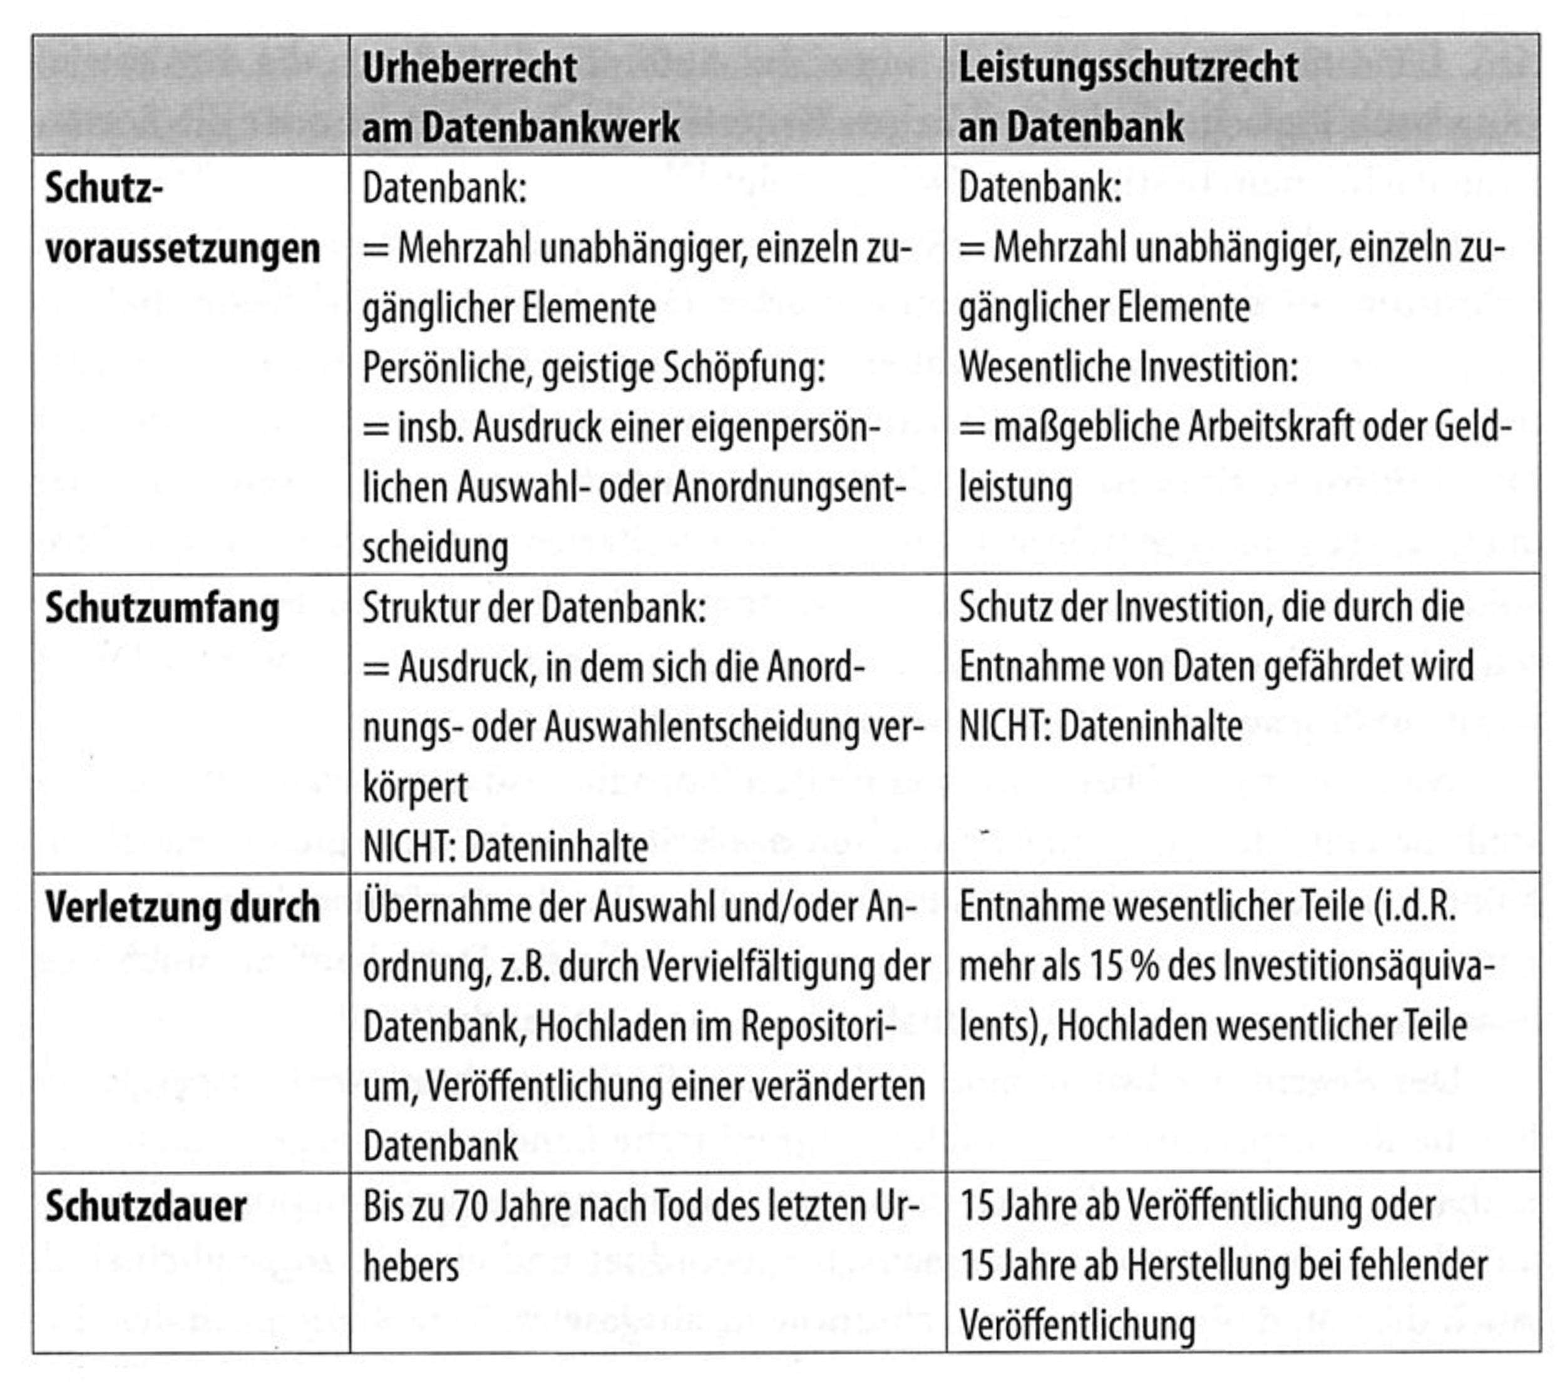
Copyright | Sui generis database rights
Tabelle aus: Paul Baumann / Philipp Krahn / Anne Lauber‐Rönsberg: Forschungsdatenmanagement und Recht. Düns/Feldkirch: W. Neugebauer, 2021. 304 S.

