Slide 1
Measurements of TSI and SSI
Werner Schmutz
PMOD/WRC, Switzerland
TOSCA Workshop
Berlin, May 14, 2012

Slide 2
Overview
Total Solar Irradiance
  Absolute calibration (first light PREMOS)
  Composites (relative calibration)
Spectral Solar Irradiance (SSI)
  SIM/SORCE
  VIRGO/SOHO

Slide 3
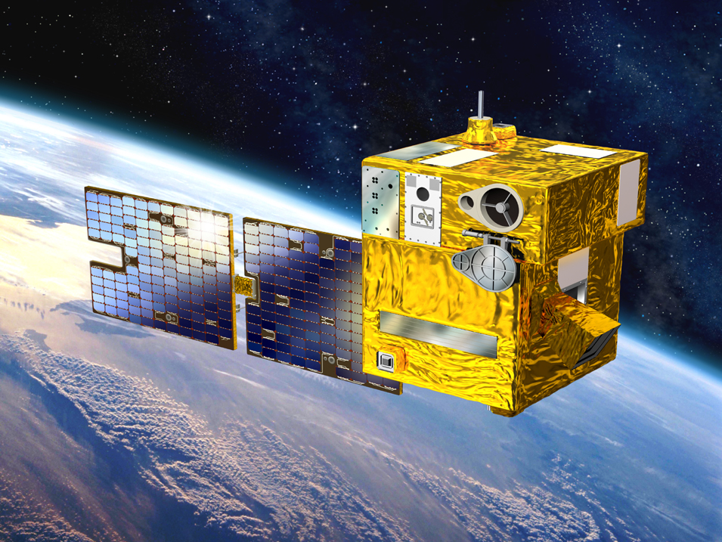
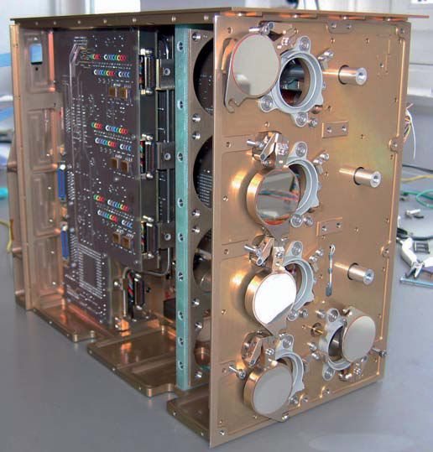
PICARD
PREMOS – SOVAP – SODISM
Filter Radiometers
Total Solar Irradiance

Slide 4
TSI calibration
PREMOS A is the first and only radiometer in space with a SI-traceable irradiance calibration in vacuum
Traceable to the irradiance calibration facility at LASP in Boulder (TRF)
Notes:
4

Slide 5
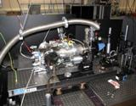
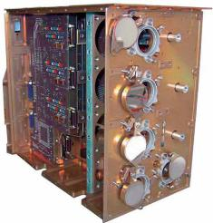
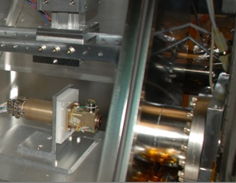
Traceability of PREMOS-TSI
PREMOS B
Comparison to cryogenic rad.
(power in vacuum)
NPL
Comparison to cryogenic rad.
(power and irradiance in vacuum)
TRF @ LASP
PREMOS A3
Notes:
5

Slide 6
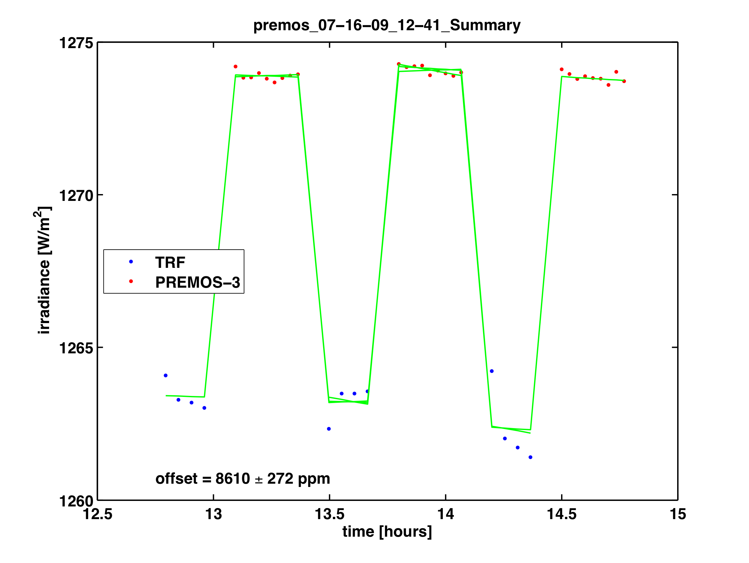
Uncertainty of the calibration
= uncertainty of TRF comparison (220 ppm)
PREMOS A
TRF radiometer
+ absolute uncertainty of TRF facility (70 ppm)
Notes:
6

Slide 7
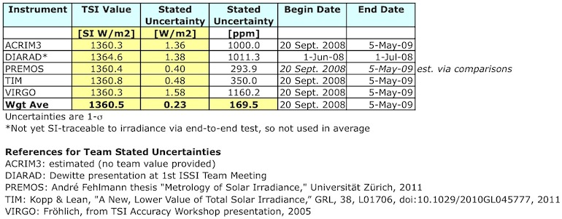
Calibration uncertainty budget
Traceable via TRF, LASP, Boulder → to NIST
Irradiance in vacuum
→ PREMOS A uncertainty: ± 280 ppm (± 0.4 W/m2)
Flight-spare recalibrations
Table compiled by Greg Kopp for an ISSI workshop March 2012
Notes:
7

Slide 8
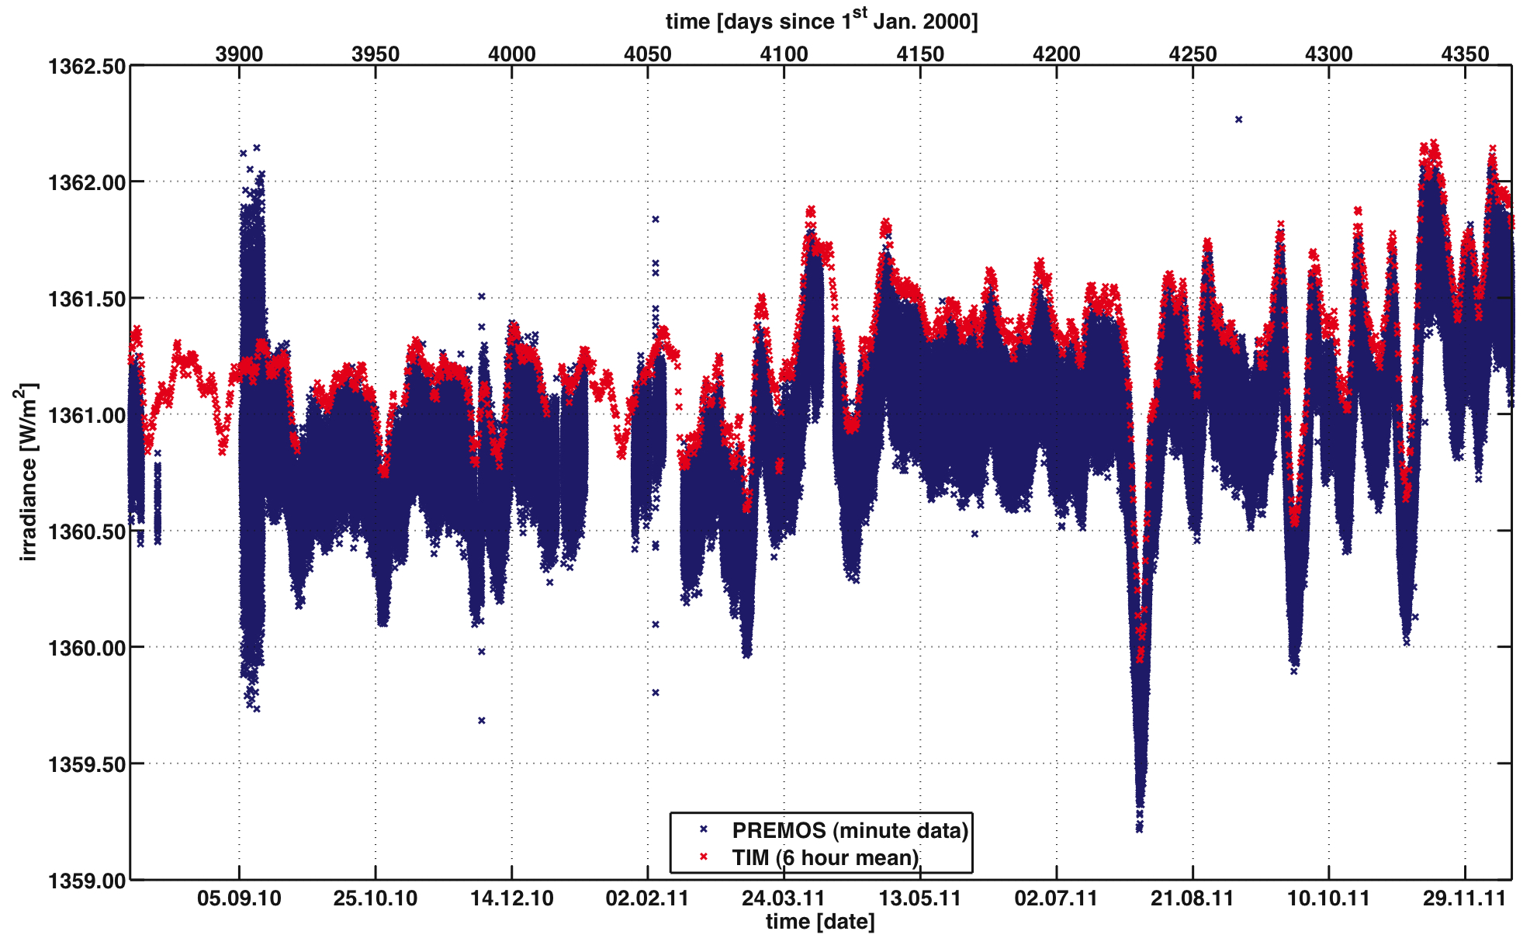
Comparison PREMOS – TIM
Notes:
8

Slide 9
Status of PREMOS-TSI
„PREMOS is in excellent health“
  PREMOS-TSI is the most accurate absolute measurement;
  ±0.4 W/m2 or ±290 ppm
  After 2 years, PREMOS-TSI has at most 50 ppm relative deviation to
  TIM/SORCE.

Slide 10
The Future of TSI observations:
Are relative observations sufficient?
Notes:
10

Slide 11
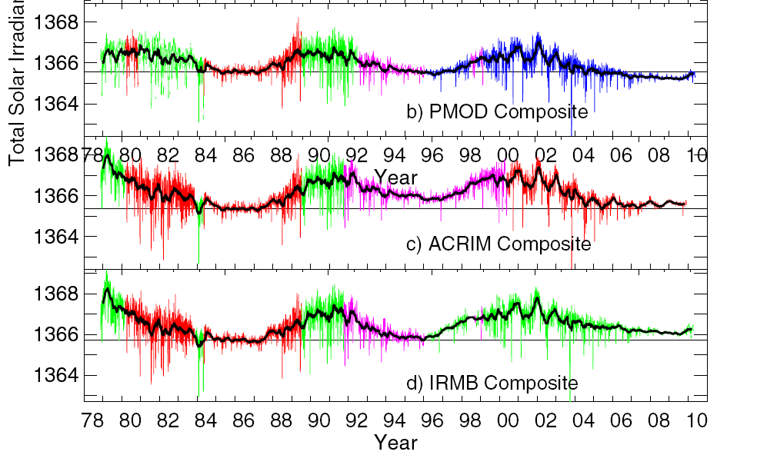
There are three TSI composites

Slide 12
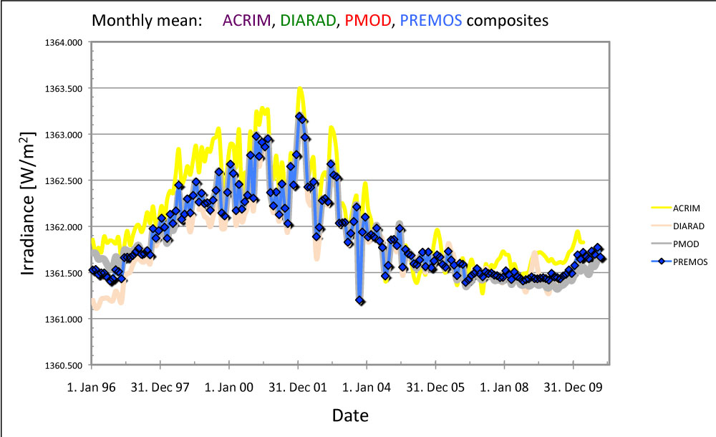
TSI-composites normalized
PMOD, ACRIM
!
normalized 2004-2005
DIARAD
Notes:
12

Slide 13
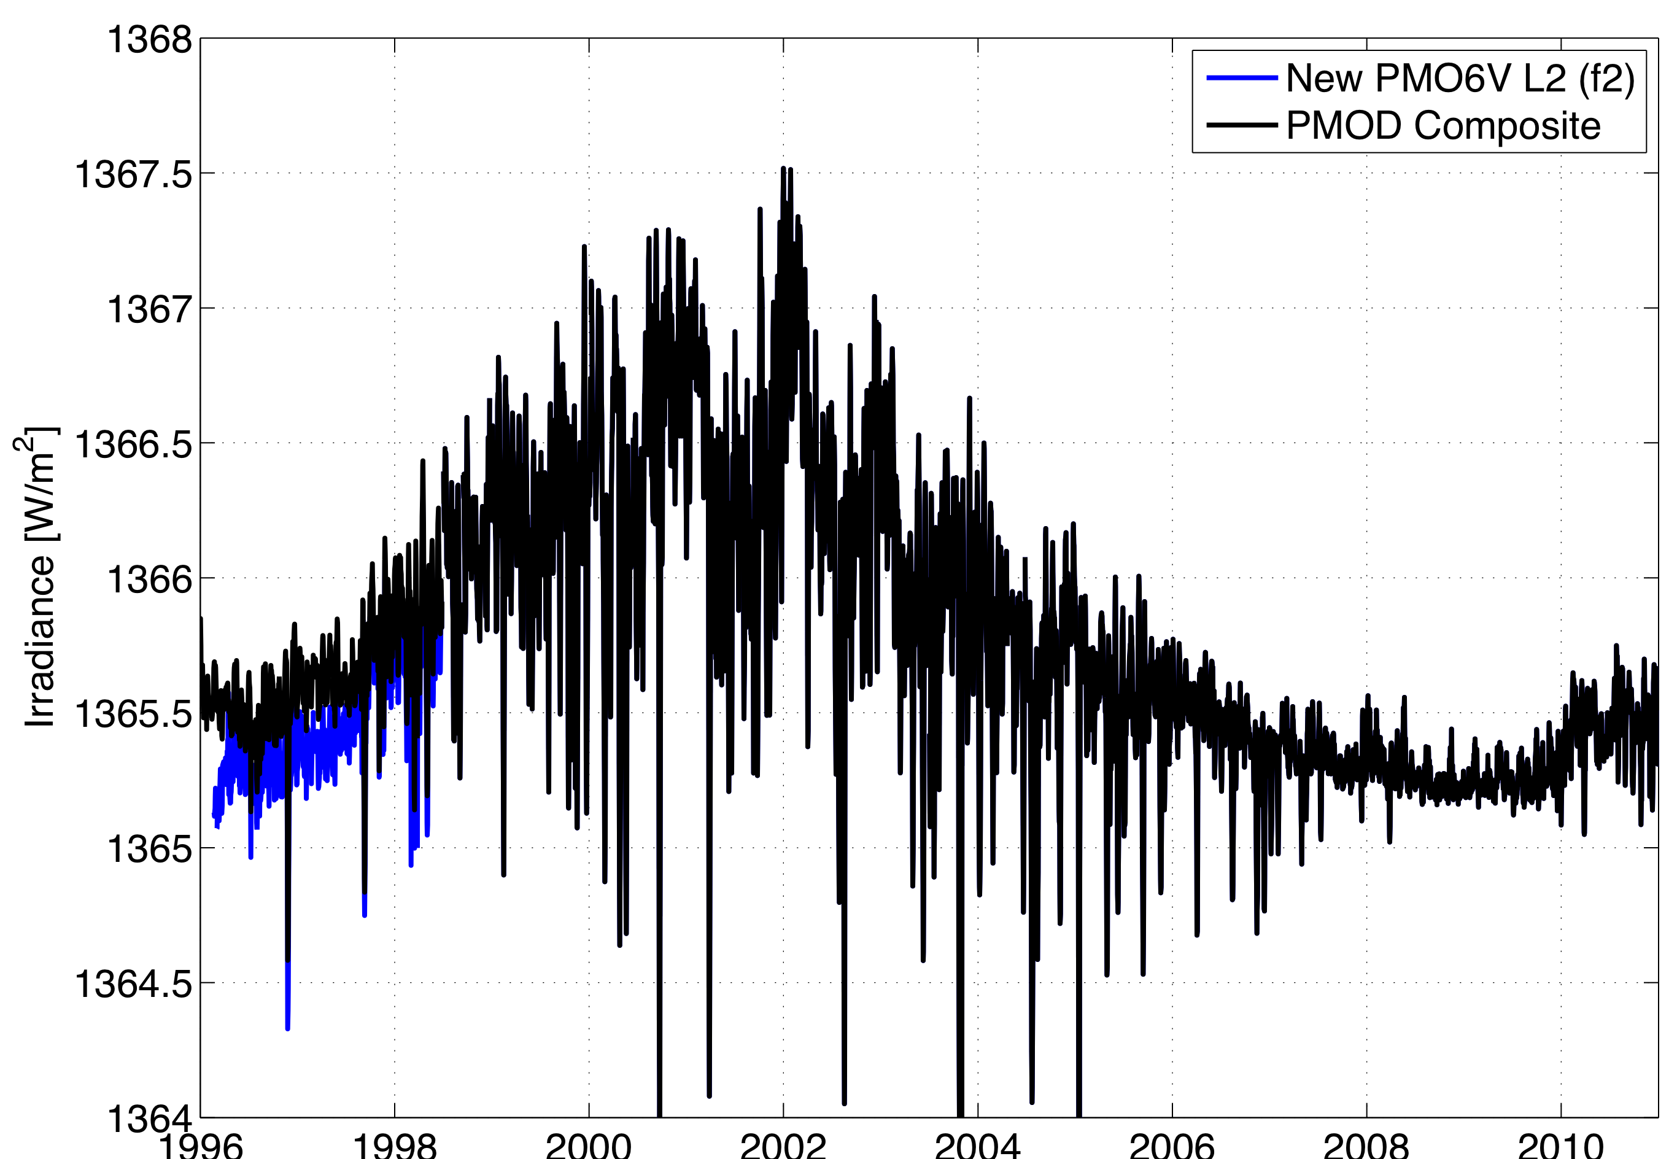
Composite 1996-2010
!
0.2 W/m²
± 0.2 W/m² / 10-years
Notes:
13

Slide 14
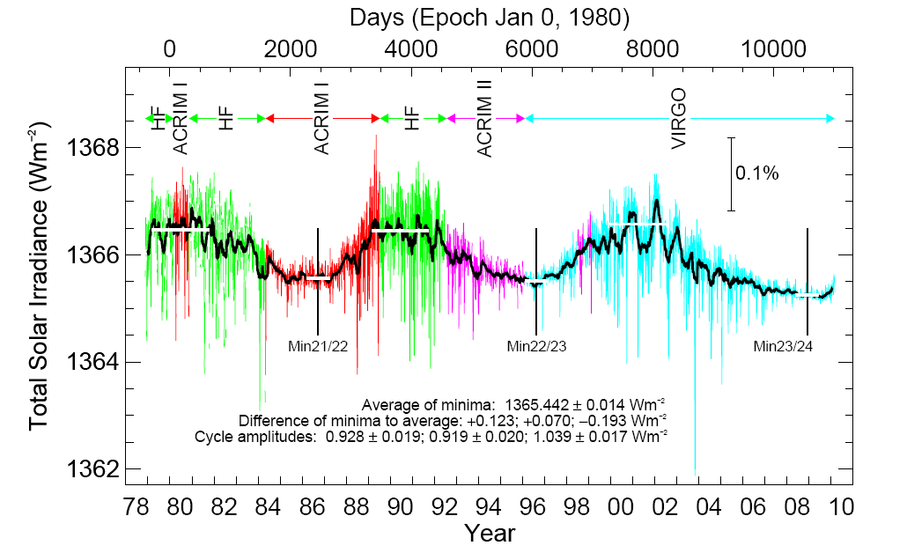
Is there a long-term trend?
Fröhlich 2009, A&AL 501, L27-L30

Slide 15
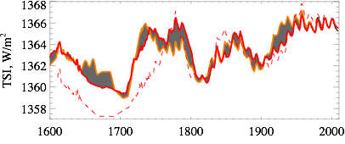
Could we detect a long-term trend with a composite?

Slide 16
Requirements for a TSI monitoring
„Any plan to rely on an unbroken
chain of measurements is broken“
  Not only because of a potential gap;
  But mainly because of the uncertainty is continuously increasing with time !
  ➔ Accurate absolute measurements are required !

Slide 17
Requirements for a TSI monitoring
  Accurate absolute measurements are required:
  Nowadays possible !
  But we certainly also want to assess the variations of TSI and therefore,
  we still need to aim for continues and overlapping data !

Slide 18
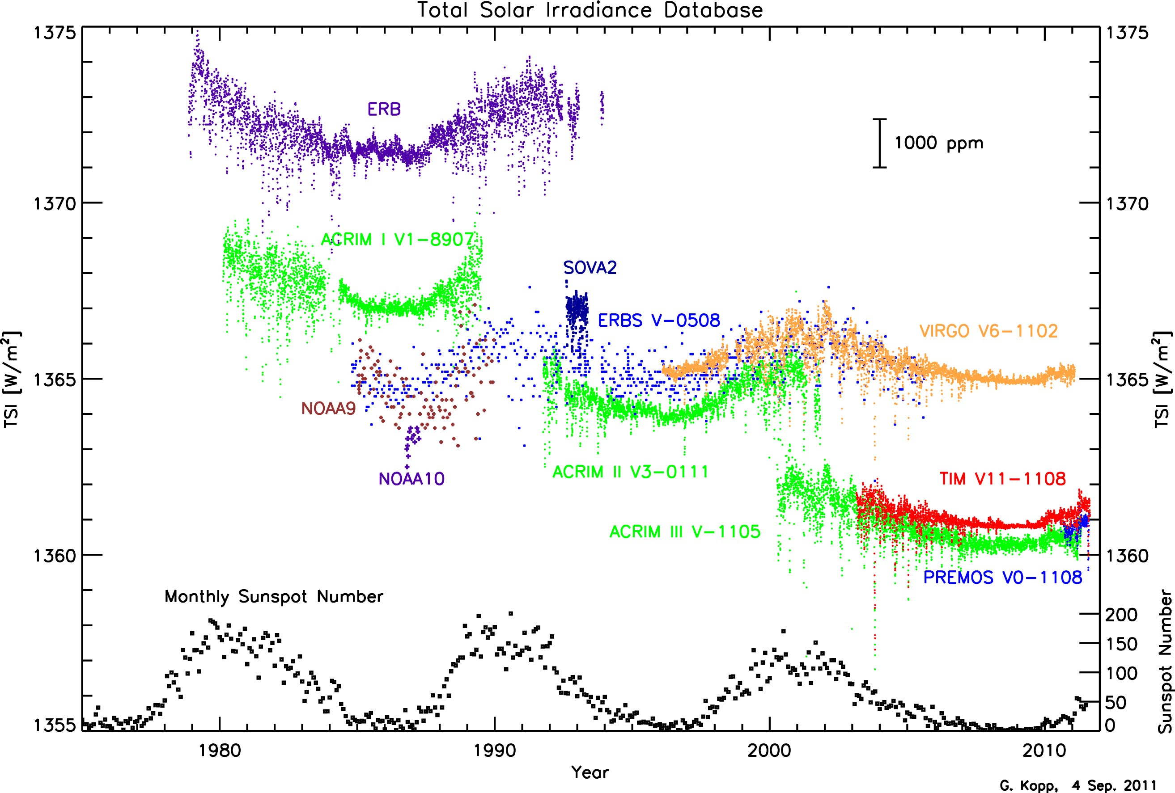
TSI monitoring today …
Presently, 4 operational space experiments observing TSI:
VIRGO (launched 1995)
ACRIM III (launched 2000)
TIM (launched 2003)
PREMOS (launched 2010)

Slide 19
Part II:
Spectral Solar Irradiance
Notes:
19

Slide 20
The open question !
The bands 410-470 and 480-730 nm are
anti-correlated to TSI variations
Compensated by larger (than TSI) UV variations
Is the SIM observation really correct?
Or is it rather a degradation problem?
Notes:
20

Slide 21
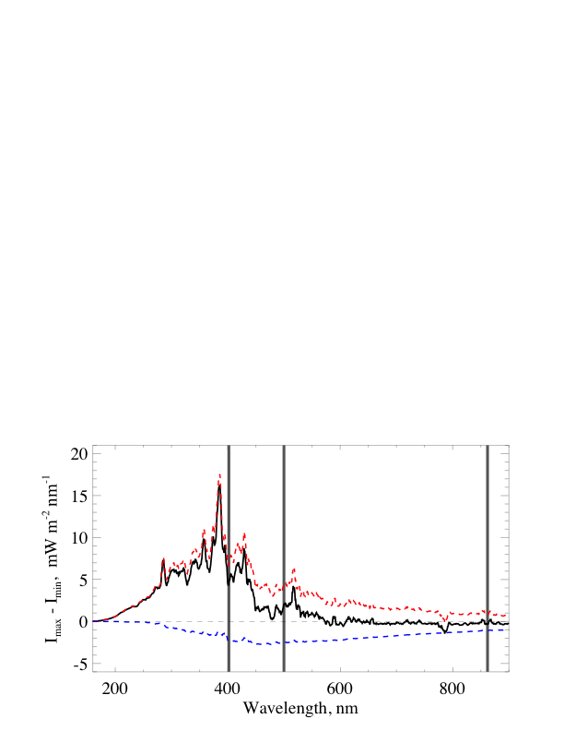
Anti-correlation in models
Contrast between active and quite Sun (SSN 150 vs SSN 0)
Black: Bright+Dark
Red: bright components
Blue: dark components
Notes:
21
shows the difference in spectral irradiance between active (SSN=150) and quiet Sun. Dashed blue curve is contribution from sunspots, dashed red curve is contribution from bright components (plage + bright network), solid black curve is total difference. Vertical lines correspond to VIRGO/SPM channels.

Slide 22
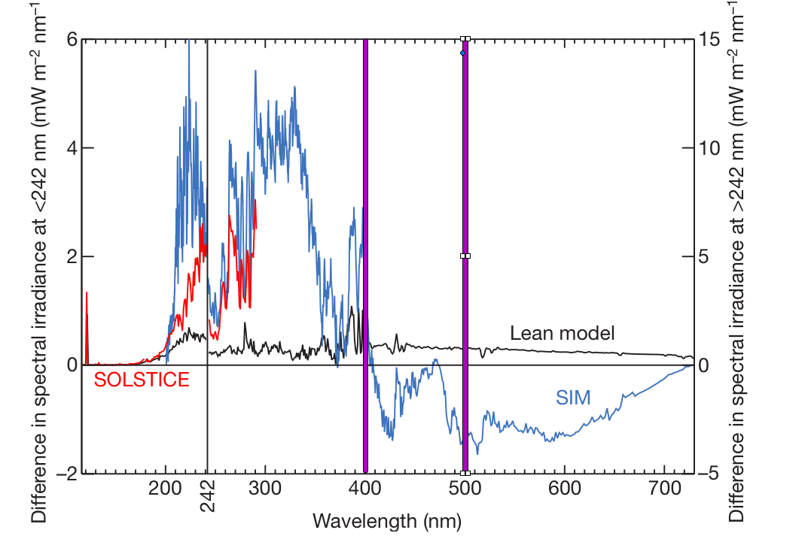
VIRGO and PREMOS bands
Notes:
22

Slide 23
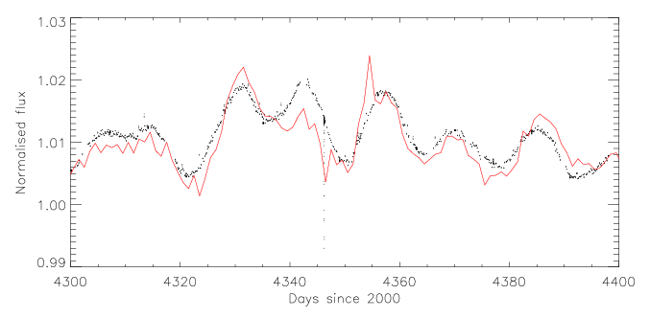
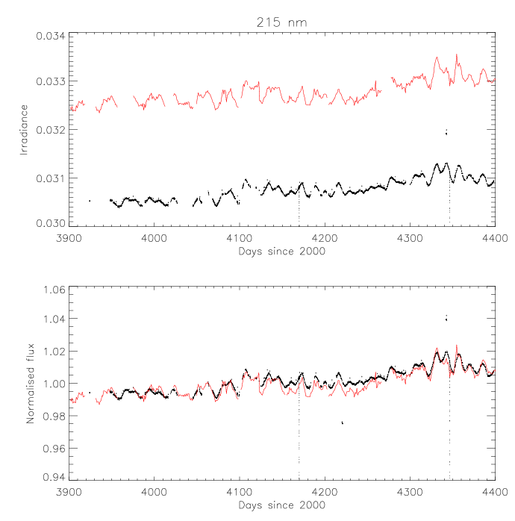
215 nm PREMOS vs SOLSTICE
Independant correction of PREMOS
Strong correlation of
13.5 and 27 days modulation
PREMOS sampling is faster
→ Rotational modulation more accurate
SOLSTICE
PREMOS
PREMOS

Slide 24
VIRGO SSI time series 1996 - now
Christoph Wehrli & VIRGO Team
PMOD/WRC Davos
An attempt to assess instrument degradation in a self consistent way by:
referring operational measurements to occasional backup operations
correcting the backup channel by initial ageing of operational channel

Slide 25
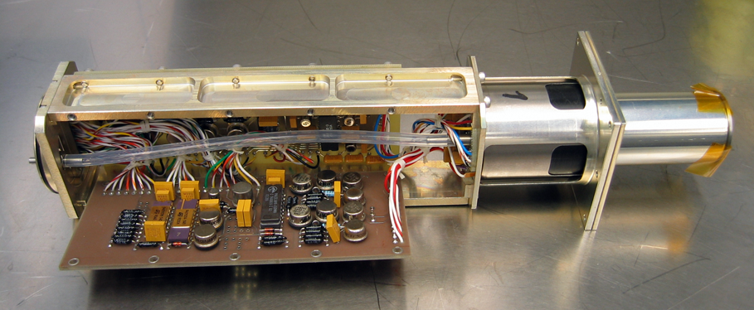
VIRGO Sun Photometers
Interference filter radiometer with 3 channels centered at 862nm, 500nm and 402nm (R,G,B); FWHM bandwidths 5nm; silicon PD detectors; rad-hard windows.
Active (SPM-A) and Backup (SPM-B) instruments
  SPM-A: exposed continuously for helioseismology application
  SPM-B: exposed rarely for solar spectral irradiance measurements
Calibrated by EG&G FEL lamps, NBS 1973 traceable
Notes:
SPM-A start 29.Jan.1996 (MD59), more than 5000 days continuous exposure
3mm BK7-G18 glass, UV cutoff below 320nm
60 sec integration time, 20 bit resolution

Slide 26
VIRGO SPM: Level1 data
SPM-B:
Number of backups 178
Total exposure time 2.6 days
Notes:
Normalized to 1AU, corrected for temperature

Slide 27
Raw variations of SPM-B
5*(TSI/<TSI>) - 4
VIRGO-SPM-B changes are about 5 times larger than the (real) solar variations in TSI.
Solar cycle 24 SSI variation is not obvious (smaller), hidden in instrumental ageing.

Slide 28
Initial ageing of SPM-A
∂TSI (*100)
Steep degradation during first hours!
Linear degradation during first month
{Commissioning activities until 29.03.1996}
Notes:
«dark» outgassing: 47 days
Switched off after 2 days, reason forgotten,
Switched on again after 1 week, then continuous operation for >16years, except for SOHO vaccation June – October 1998

Slide 29
Ageing of SPM-A and SPM-B versus exposure time
→ polynomial fit SPM-A
Notes:
Obviously initial ageing is different for identical instruments!
Slower degradation in Red and Green for intermittent exposure! (Blue similar after 1 day)
SPM-B measured sequentially R-G-B

Slide 30
SPM-B corrected by operational degradation of SPM-A
Instrumental effects dominating over solar cycle
Notes:
Steady decrease after 2001, about 4 times stronger in R and G than TSI in SC23

Slide 31
Empirical Approach
SSI timeseries represent a mixture of Solar Cycle and instrumental effects
Active & Backup SPM degrade differently in time or exposure time
Linear correction accounts for probable decline of SSI, i.e. first order estimation of instrumental effect.
Exponential correction eliminates most of solar cycle variation as well

Slide 32
Linear vs. Exponential Detrending: → what does it to TSI ?
Notes:
Slope of linear fit strongly depends on selected epoch, besides it is constant
Slope of exponential fit is variable over epoch, less dependent of epoch at a given instance

Slide 33
Linear Detrending 2000-2012

Slide 34
Summary
Normalization of SPM-A by SPM-B:
  Larger than expected variations of Backup channel
  → “instrumental effects”
    Rapid initial degradation in Active channel
    versus
    ‘Early increase’ of Backup (not observed in operational channel)
Empirical correction of SPM-B:
fitting degradation in time with:
  Linear or exponential detrending yields positive correlation
  with solar cycle (TSI) in
    → all 3 visible channels !!!
None of VIRGOS’s wavelength bands
862 nm, 500 nm, 402 nm
is
anti-correlated to TSI variations
Notes:
Schwarzschild Effekt: reduzierte Filmempfindlichkeit bei langer Belichtung
Fehlerabschätzung, diverse Perioden von SPM-A fitten, Streuung auf SPM-B -> Unsicherheiten.
J. Harder wird mir Daten mit S/N Fehlerbalken geben.

Slide 35
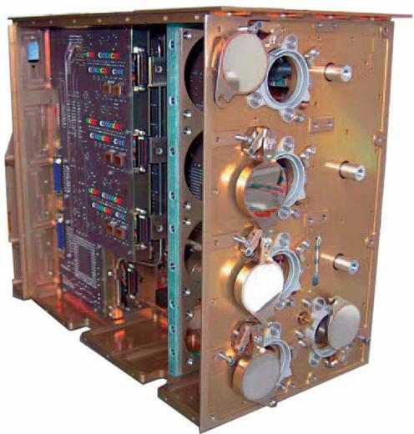
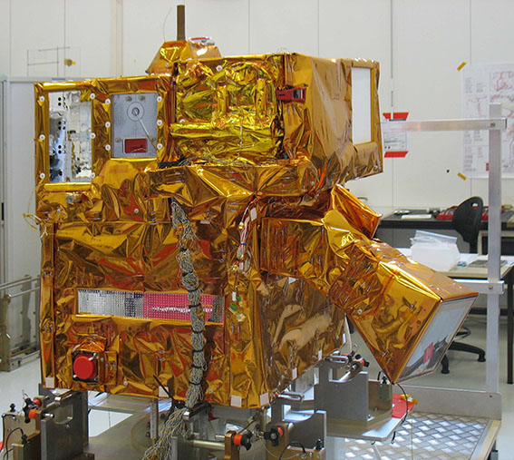
Thank you for your attention
PREMOS PICARD

Slide 36
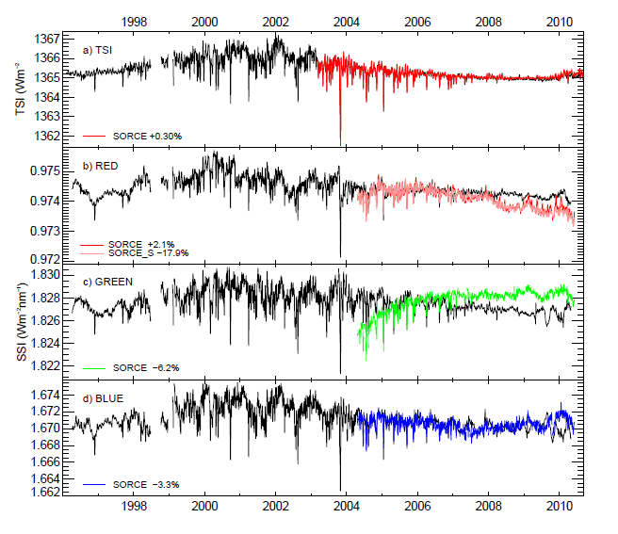
Alternative analysis including proxies
(C. Fröhlich, EGU 2011)
SORCE
Empiric correction versus Time (double exponential), Temperature (linear + Boltzmann), TSI and Mg-II Index.
Notes:
13 free parameters

